Slide 1

Demystifying Palliative and Hospice Care
Pharmacotherapy PHARM 5315: Oncology
Jennifer Pruskowski, PharmD, BCPS, BCGP, CPE Assistant Professor
University of Pittsburgh School of Pharmacy Department of Pharmacy and Therapeutics
Spring 2020

Slide 2
Objectives
1. Compare and contrast the eligibility criteria, services provided, and counseling points for palliative and hospice care
2. Describe the role of the palliative and hospice care pharmacist

Slide 3
AUDIENCE POLL
What do you know about palliative and hospice care?
Who has had experiences with palliative and/or hospice care?
What questions do you have?

Slide 4

Meet AB
48 y/o self-identified Caucasian female
Diagnosed with T3N0M1
Appendiceal Cancer
  Approximately 3 ½ years ago
  S/p many treatments
  May not be any more options
(s/p 1 week after HIPEC)
When I saw her: “I can’t eat
and I am over this – can’t I just get some marijuana?”
HIPEC: Hyperthermic intraperitoneal chemotherapy

Slide 5

The Big Picture
Palliative Care:
A philosophy of care focusing on quality of life for patients with life- limiting illness
Palliative Care
Hospice Care:
(a form of palliative care) Focuses on those in the last weeks/few months of life. It is considered a Medicare benefit in the United States
Hospice Care

Slide 6
DEMYSTIFYING PALLIATIVE CARE

Slide 7
What is Palliative Care?
Palliative comes from the Latin word “palliare”:
to cloak
Palliate:
  To make the effects of (something, such as an illness) less painful, harmful, or harsh
  To ease (symptoms without curing the underlying disease)
  To moderate the intensity of
http://www.merriam-webster.com/dictionary/palliate

Slide 8
Palliative Care:
Provides a specialized approach to persons (of all ages) with serious illness (involving any organ system) that focuses on alleviation of suffering and improved quality of life
Is delivered by an interdisciplinary team of professionals that deploys a broad array of knowledge and skills
  Emphasizing coordinated and continuous care in institutional or home settings

Slide 9
Clinical Sidebar
“The 3-Cs of Palliative Care”:
Communication
Comfort
Coordination
Am J Health Syst Pharm. 2017 Jan 1;74(1):e6-e8.

Slide 10
Who is Palliative Care For?
Appropriate Candidates:
Diagnosis of at least one life-threatening (chronic) illness
AND
(At least one of the following:)
Experiencing extensive, intolerable symptoms
Difficulty determining goals (currently/future), “quality of
life” or wishes at the end of life
Would benefit from additional counseling and/or support
Require additional help when determining discharge planning

Slide 11
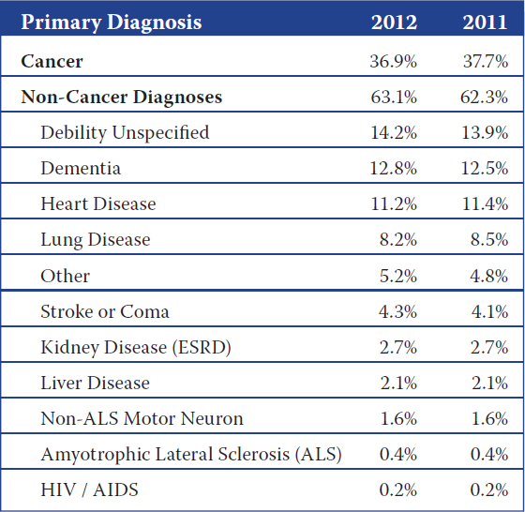
What is a life-limiting illness?
Health condition that affects a
patient’s survival rate, that cannot be cured
Not just cancer!
http://www.nhpco.org/sites/default/files/public/Statistics_Research/2013_Facts_Figures.pdf

Slide 12
Where Does Palliative Care Occur?
Continuum of Care:
  Location: can be provided in the hospital,
outpatient clinics, nursing homes… everywhere
  Role within health care:
    Potentially at the time of diagnosis (of the life-limiting illness)
    Given in conjunction with curative therapies

Slide 13
The Continuum of Care
Pre-Palliative Care (OLD) Model
Curative/Disease Controlling
Therapy
Palliative Care and Hospice
D E A T H
Diagnosis of a Life Threatening Disease
Time or Disease Progression
“Where there are NO options left”

Slide 14

The Continuum of Care
Palliative Care (NEW) Model
Curative/Disease Controlling Therapy
H D
E A T H
o
s p i c e
Palliative Care
Diagnosis of a Life Threatening Disease
Time or Disease Progression
Palliative Care is given as part of the treatment plan.
J Pain Symptom Manage. 2002 Aug;24(2):106-23.

Slide 15
How Does Palliative Care Work?
Communication
Comfort
Advance Care
Planning
GoC Conversations
Symptom Management Experts
Coordination
Support
Hospice Evaluation
GoC: goals of care

Slide 16
Advance Care Planning
Advance care planning involves learning about the types of decisions that might need to be made, considering those decisions ahead of time. Those decisions are often by put into an advanced directive
– Advance directive: a legal document that goes into effect only if the patient is incapacitated and unable to speak. Patient themselves can fill out
Decisions include: DNR/DNI, Abx use, etc.
DNR/DNI: Do Not Resuscitate or Intubate; Abx: antibiotic use

Slide 17
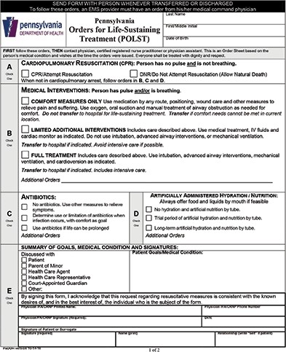
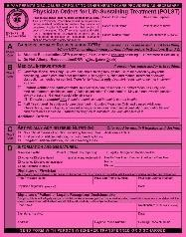
POLST
Medical order for the specific medical treatments the patient wants during a medical emergency
– Signed by a physician
Works together with advance directives
Usually printed on bright pink paper
POLST: Pennsylvania/Physician’s Orders for Life-Sustaining Treatments

Slide 18
Goals of Care (GoC) Discussions
Consist of putting prior advance care planning conversations about wishes into the current clinical context
  Includes more than DNR/DNI
Discuss with patient’s and/or families’:
  What defines a good quality of life/death
  Values, spiritual beliefs and wishes
Afterwards, the palliative care team translates into medical plan
DNR/DNI: Do Not Resuscitate or Intubate

Slide 19
Symptom Management
Some Examples:*
  Pain
  Shortness of breath
  Cough
  Nausea/vomiting, constipation, diarrhea
  Depression, anxiety
  Anorexia & weight loss
  Fatigue
  Hiccups
  Itch
  Insomnia
* Not all inclusive

Slide 20
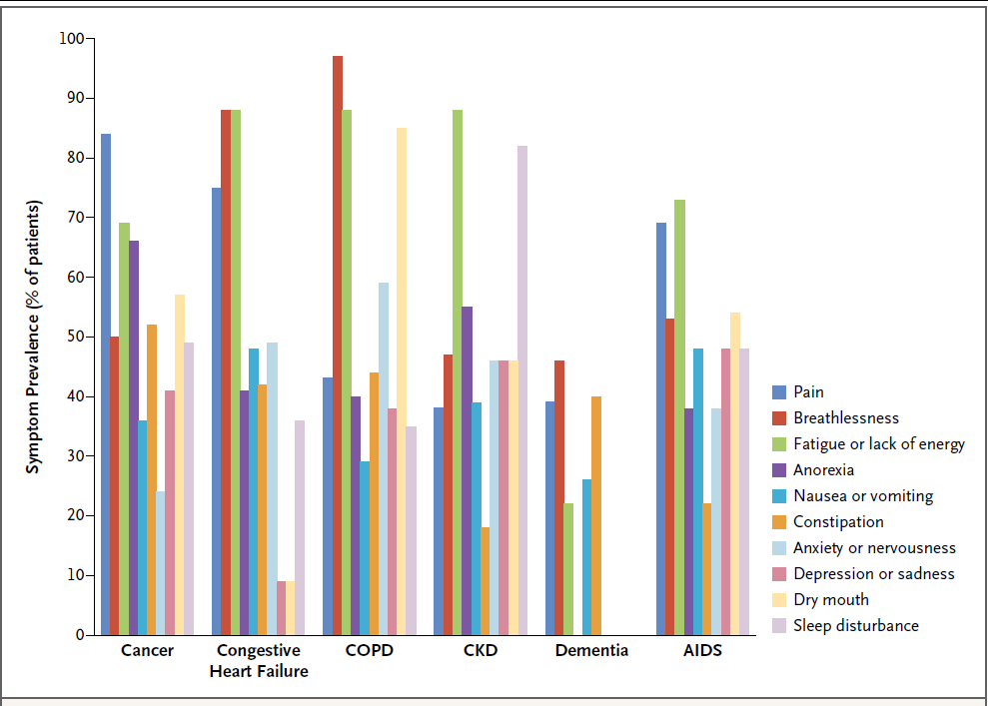
Figure 1: Symptom prevalence in advanced illness.
N Engl J Med. 2015 Aug 20;373(8):747-55.

Slide 21
POP QUIZ
What is the number one symptom patients complain of?:
  A. Pain
  B. Nausea
  C. Fatigue
  D. Dyspnea (shortness of breath)

Slide 22
POP QUIZ
Which of the follow symptoms is the most debilitating for patients?:
  A. Pain
  B. Nausea
  C. Fatigue
  D. Dyspnea (shortness of breath)

Slide 23
Support
Palliative Care Social Workers:
  Financial support
  Family support (especially help with young children)
Chaplains:
  Emotional and spiritual support
N Engl J Med. 2004 Jun 17;350(25):2582-90.

Slide 24
Why Palliative Care?
There are many benefits to palliative care:
  Improves quality of life
  Improves quality of care
  Improves symptoms:
    Fatigue, pain, depression, anxiety, dyspnea, sleep and well-being
    More than 50 % patients significantly improved after one single supportive/palliative care consultation
Chest. 2007 Sep;132(3uppl):404S-422S.
J Pain Symptom Manage. 2010 Aug 24. [Epub ahead of print] Support Care Cancer. 2013 Nov 16. [Epub ahead of print]

Slide 25
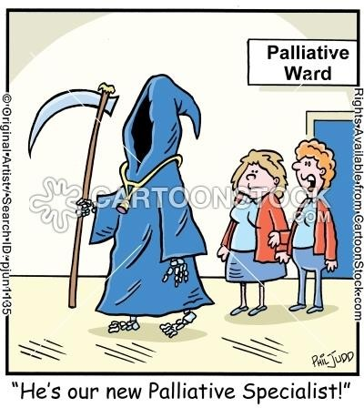
DEBUNKING MYTH #1:
Palliative Care Hastens Death
http://www.cartoonstock.com/newscartoons/cartoonists/pju/lowres/pjun1135l.jpg

Slide 26
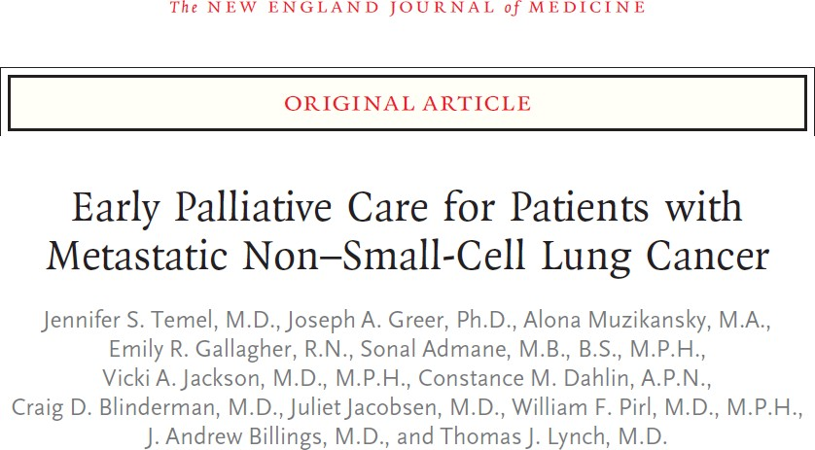
The Landmark Trial
Randomly assigned patients with newly diagnosed metastatic non-small-cell lung cancer to receive either early palliative care integrated with standard oncologic care, or stand oncologic care alone (n=107 upon final assessment)
Primary Outcome: Change in quality of life (QoL) at 12 weeks
QoL: quality of life
N Engl J Med. 2010 Aug 19;363(8):733-42.

Slide 27
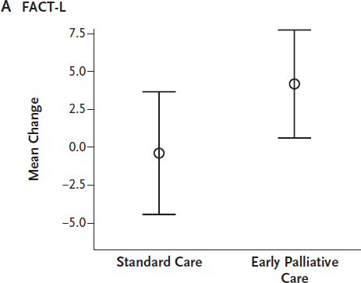
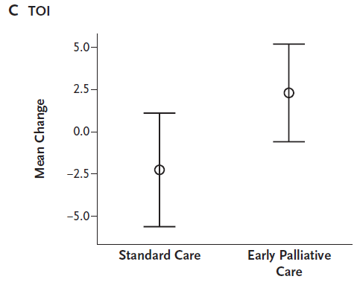
Figure 1: Mean changes in quality-of-life (QoL) scores from baseline to 12 weeks in two study groups.
P = 0.09
P = 0.04
FACT-L: Functional Assessment of Cancer Therapy - Lung
TOI: Trial Outcome Index (sum of scores on lung-cancer subscale (LCS), and the physical and functional well-being subscales of FACT-L scale)
Higher scores indicate a better quality of life
TOI: mean changes in scores: -2.3 +/- 11.4 vs. 2.3 +/- 11.2, difference between groups: 4.6; 95% CI: 0.2-8.9, P = 0.04
N Engl J Med. 2010 Aug 19;363(8):733-42.

Slide 28
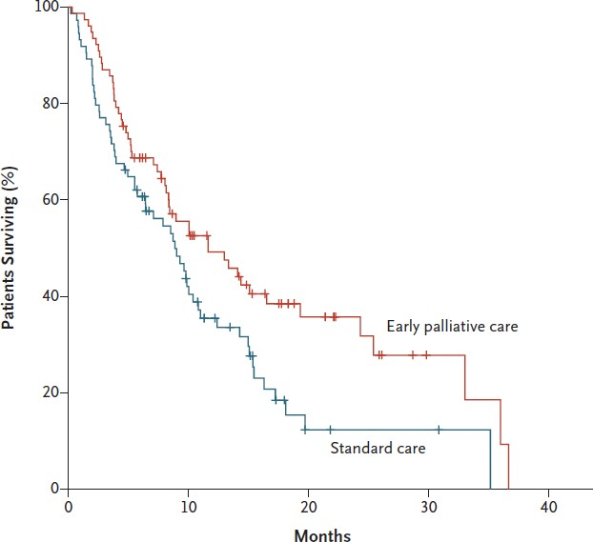
Figure 3: Kaplan-meier estimates of survival according to study group.
P = 0.02 with the use of the log-rank test
Median estimates of survival were: 9.8 months (in entire sample), while 11.6 months (early palliative care group) to 8.9 months (standard care)
N Engl J Med. 2010 Aug 19;363(8):733-42.

Slide 29
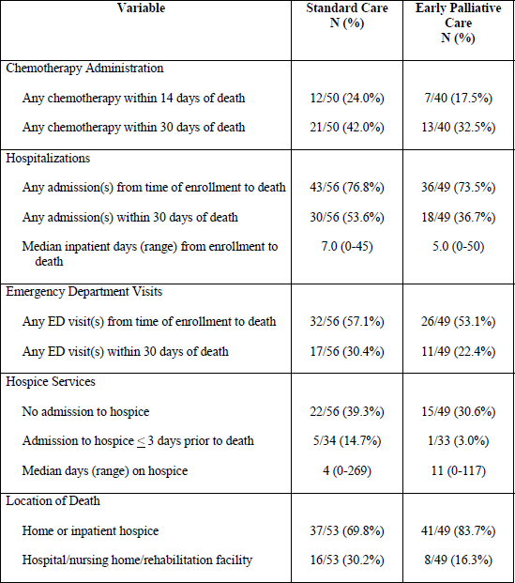
Supplemental Table 2: Healthcare utilization measures.
Although study did not have adequate power to examine specific indicators, those patients receiving standard of care did appear to receive more aggressive care near the end of life
N Engl J Med. 2010 Aug 19;363(8):733-42.

Slide 30
So Let’s Think:
Would AB qualify for palliative care?:
What services could palliative care offer?
Would AB need to stop chemotherapy?

Slide 31
DEMYSTIFYING HOSPICE CARE

Slide 32
What is Hospice Care?
Hospice comes from the Latin words “hospitium”: hospitality, inn, lodging, and “hopes”: both “host and guest”
Hospice Care:
  Program of care and support for people who are terminally ill (within last weeks/few months of life)
  Focus is on comfort, not curing. Supports death with dignity

Slide 33
Hospice History
In 1982, Congress included a provision to create a Medicare hospice benefit in the Tax Equity and Fiscal Responsibility Act
– Part of Medicare Part A
Optional state plan service that includes an array of services furnished to terminally ill individuals
These services are carried out by non- governmental agencies

Slide 34
Who is Hospice Care For?
Appropriate Candidates:
Prognosis of <6 months – certified by 2 physicians (primary physician and hospice medical director)
Patient has consented to accept hospice services in lieu of Medicare reimbursement for curative disease care
Lives in service area of the provider organization
Notice what is not in the eligibility criteria:
– Does not include DNR/DNI or agreeing to not return to the hospital
DNR/DNI: Do Not Resuscitate or Intubate

Slide 35
POP QUIZ
When prognosticating a patient (considering how long they patient has to live), providers?:
  A. Over-prognosticate
  B. Under-prognosticate
  C. Get it just right
  D. I have no idea

Slide 36
How do we know if it <6 months?
Prognosis is always uncertain
  Physicians overestimate survival by a factor of 5.3¹
  There are some tools:
    ePrognosis
      http://eprognosis.ucsf.edu/
    SEER (Surveillance, Epidemiology, and End Results Program)
      http://seer.cancer.gov/
    Statistical models estimate clinical trajectory of some chronic
diseases
Providers prognosticate in ranges:
  “Hours to days”, “days to weeks”, “weeks to months”
There is NO penalty if a patient does survive longer
1. BMJ. 2000 Feb 19;320(7233):469-72.

Slide 37
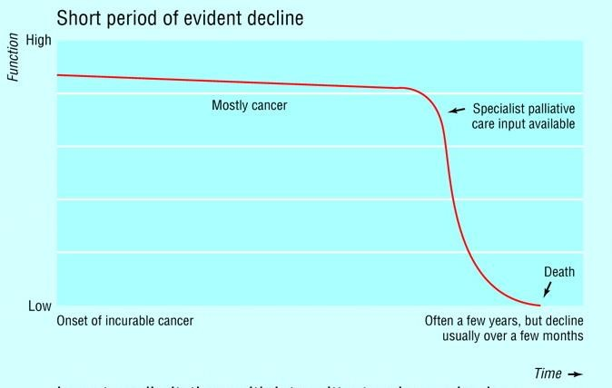
Disease Trajectory: Cancer (Solid Tumor)
http://www.scotland.gov.uk/Publications/2008/10/01091608/3

Slide 38
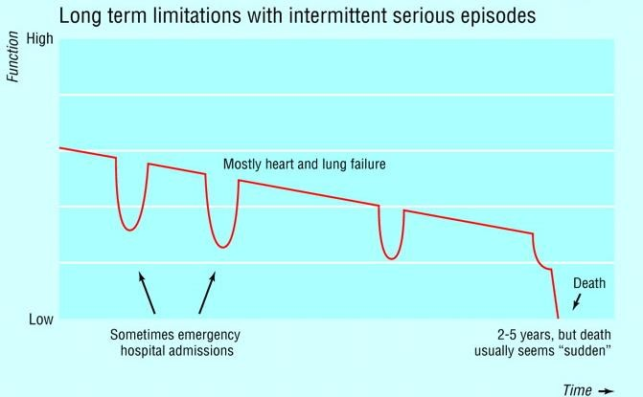
Disease Trajectory: Chronic Disease Failure (i.e. CHF, COPD)
http://www.scotland.gov.uk/Publications/2008/10/01091608/3

Slide 39
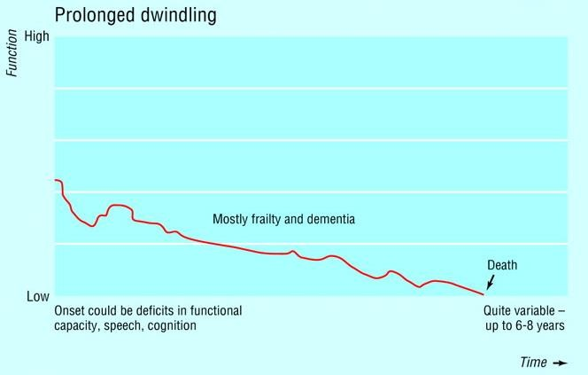
Disease Trajectory: Frailty and Dementia
http://www.scotland.gov.uk/Publications/2008/10/01091608/3

Slide 40
Contingencies
Patient can revoke hospice care at any time:
  Unexpected improvement
  Change of goal of care
  For any reason
After the first 6 month period eligibility must be recertified every 60 days by the hospice physician
  Hospice may be continued as long as the diagnosis and the 6-month prognosis persists

Slide 41
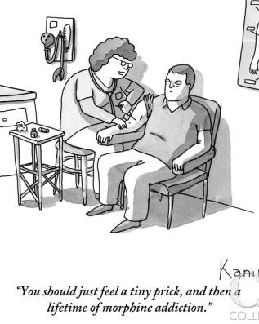
DEBUNKING MYTH #2:
When you go to hospice all you get is morphine…

Slide 42
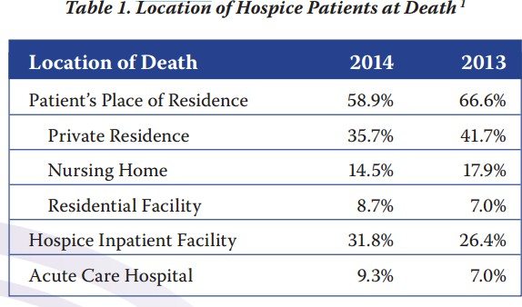
Where Does Hospice Care Occur?
Most patients receive at home (care is provided by family members or other caregivers)
http://www.nhpco.org/sites/default/files/public/Statistics_Research/2015_Facts_Figures.pdf

Slide 43
How Does Hospice Care Work?
Access to an interdisciplinary team:
  Physician, nurses aid, social worker, and chaplain
  24/7 line to call with emergencies – but not 24/7 care
All durable medical equipment, medical supplies, and medications*
Access to an inpatient facility for :
  Acute problems or imminent death
  Respite care
Bereavement services to surviving
“family” for 13 months
At NO
COST to the patient
* At the discretion of the hospice

Slide 44
POP QUIZ
Approximately how much money does a non- governmental hospice agency get for 1 hospice patient (being treated at home) per day?:
– A. $150
– B. $300
– C. $600
– D. $1000

Slide 45
So Let’s Think:
Would AB qualify for hospice care?:
What services could hospice care offer?
Would AB need to stop chemotherapy?

Slide 46
THE ROLE OF THE PALLIATIVE AND HOSPICE CARE PHARMACIST

Slide 47
Role of the Pharmacist
Crucial and multifactorial:
Screener
Provider
Educator
Monitor
Formulary Manager
Gatekeeper
Focus on the 3-Cs

Slide 48
Comfort
Can work within your collaborative agreements, or provide recommendations to your IDT to take care of patients
Specifically:
  Second layer of assessment – take thorough “drug histories” (remember “U” of the “PQRSTUV”)
  Think about non-opioid options (specifically adjuvants)
  Utilize pharmacokinetic, pharmacodynamic and evidence-based knowledge to tailor regimens to patients
IDT: interdisciplinary team

Slide 49
Communication
Can utilize ACP conversations and GoCs to translate into medication regimen
Deprescribing:
  The systematic process of identifying and discontinuing drugs in instances in which existing or potential harms outweigh existing or potential benefits within the context of an individual
patient’s care goals, current level of functioning,
life expectancy, values, and preferences.
ACP: advance care planning; GoC: goals of care
JAMA Intern Med. 2015 May;175(5):827-34.

Slide 50
POP QUIZ
What is the prevalence of statins for patients with life-limiting illness, at or near the end of life (within 6 months of death)?
– A. 0%
– B. 20%
– C. 30%
– D. 50%

Slide 51
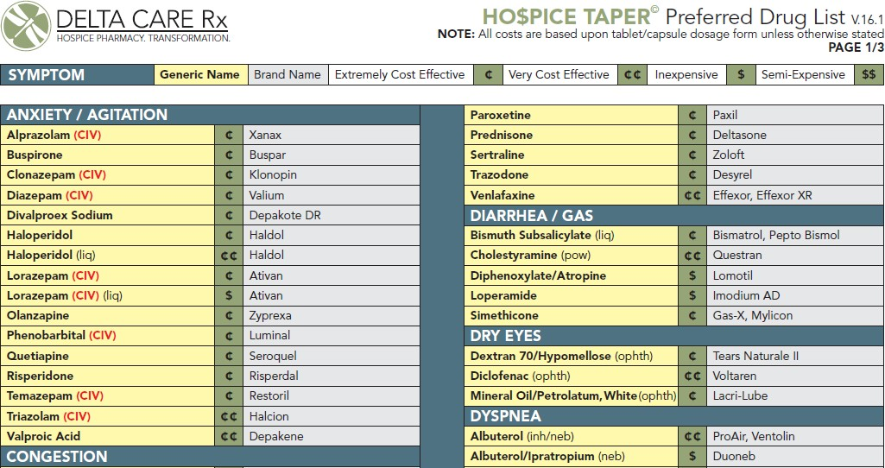
Coordination
Ensure a seamless pharmacological pass-off
– Work with hospice agencies and palliative care SW to see what can be covered via hospice formulary
SW: social worker

Slide 52
DEBRIEF

Slide 53
Resolution of AB’s Case
Talked about goals and values
Decided to go home with hospice care
Sent home with dronabinol (at that time
medical marijuana wasn’t approved in PA)
Passed a few months later

Slide 54
Clinical Sidebar
Why are we talking about this? Why is this important?:
  These terms will come up with family members
  I want you to be able to demystify what these services mean
  The hardest cases: when family members do not talk about what they want

Slide 55
Clinical Sidebar
Talking to patients about palliative and hospice care:
  There are many myths, many perceptions
    We ask patients: “have you had any experiences with hospice and/or palliative care services?”
  Usually present as “pain and symptom management agents”
  UPMC Palliative and Supportive Institute: “It’s all about the living”!

Slide 56
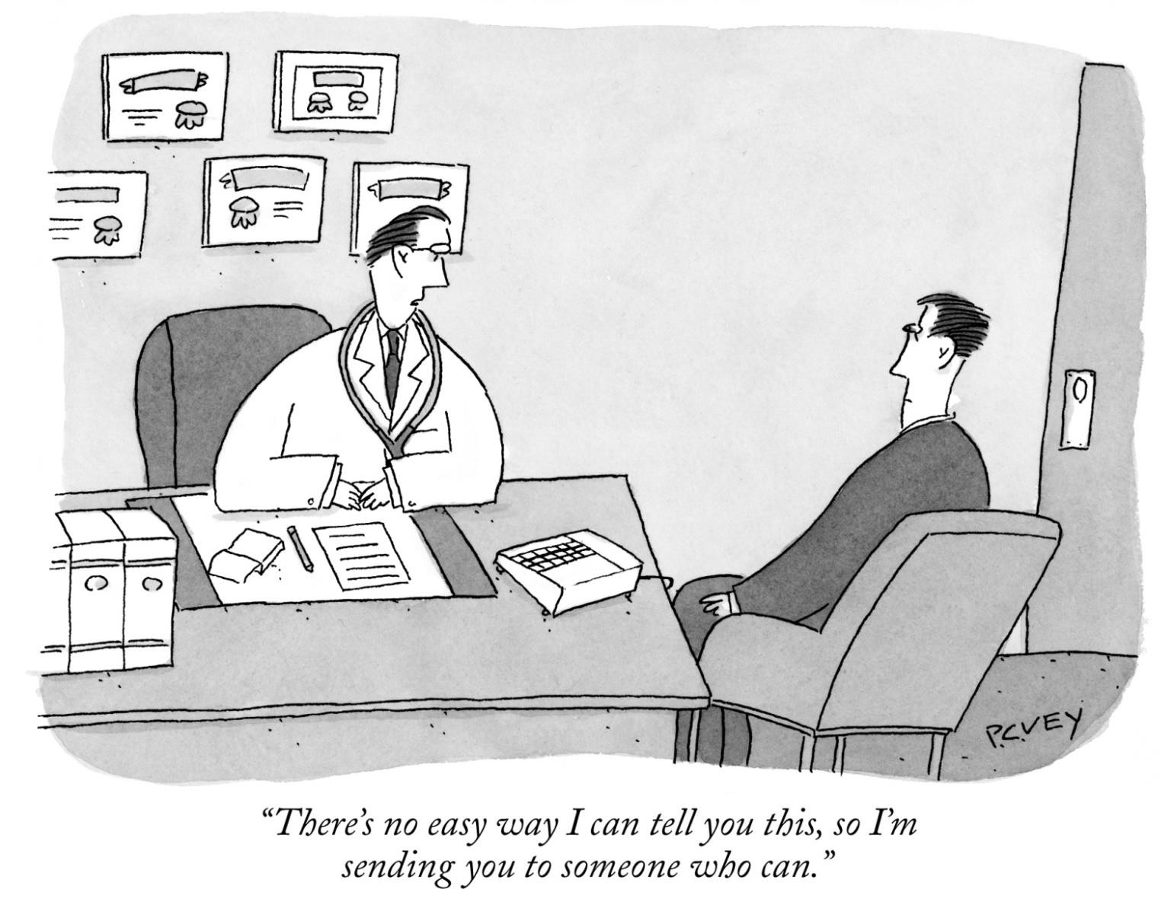
The Truth

Slide 57
Debrief Questions
What new information did you learn today? What surprised you?
What do you still not understand?
What other questions do you have?

Slide 58
*Clinical Pearls*
Palliative care is a philosophy of care
Hospice is part of Medicare Part A
Pharmacists play a crucial role

Slide 59
Any Questions?
THANK YOU!

Slide 60
Contact Information
Jennifer Pruskowski, PharmD, BCPS, BCGP, CPE
Palliative Care Clinical Pharmacy Specialist | Assistant Professor, University of Pittsburgh School of Pharmacy, Department of Pharmacy and Therapeutics
UPMC Palliative and Supportive Institute Iroquois Building | Suite 308.15
3600 Forbes Avenue at Meyran Avenue | Pittsburgh, PA | 15213
Office: 412-864-2899 | Cell: 412-463-6217 |
Email: pruskowskija@upmc.edu

