Slide 1


Slide 2

Who is ISPOR?
International Society for Pharmacoeconomics and Outcomes Research
Mission and Vision: Promote health economics and outcomes research (HEOR) excellence to improve decision making for health globally.
Consists of over 20,000 individual and chapter members from 110⁺ countries worldwide
  Student Network: 1,700⁺ individual members and 2,500 chapter members from 70⁺ countries

Slide 3
Where does someone in HEOR fit in?
Roles:
  Academia
  Analytics
  Clinical
  Communications
  Consulting
  Finance
  Government Affairs
  Information Technology
  Management
  Market Access
  Marketing
  Media
  Operations
  Pharmacy
  Product Development
  Quality Improvement
  Recruiter
  Reimbursement
  Research
  Risk Management
  Sale/Business Development
  Strategic Planning

Slide 4
What ISPOR does:
Provides an environment where students can share knowledge in pharmacoeconomics and health outcomes research
Serve as a bridge in bringing together students interested in pharmacoeconomics and members of the pharmaceutical industry, health-related organizations, and academia
Act as a resource for new students interest in pharmacoeconomics and outcomes research
Provide an opportunity for student chapter members to become familiar with the affairs of ISPOR as well as have representation in affairs
Coordinate with other student organization to help provide enriching educational experiences pertaining to pharmacoeconomics and outcomes research

Slide 5
ISPOR Membership Perks
Networking Opportunities
  Other PhD, masters, and PharmD students with similar interests all across the world
  Experienced mentors in health economics and outcomes research
Customized educational webinars
Student Travel Grant Awards
Professional development and leadership opportunities
Annual competition and awards for participation in Student Network Activities:
  Research Competition, Outstanding Student Chapter, Newsletter Quizzes, T-Shirt Competition, and Student Recruitment Campaigns
Full access to:
  ISPOR publications, Dymaxium’s Formulary Decisions, ISPOR Global Internship & Fellowship Directory, ISPOR HEOR Career Center

Slide 6
International Conferences
ISPOR Summit 2019 ▪ October 11th ▪ Baltimore, MD
ISPOR Europe 2019 ▪ November 2-6 ▪ Copenhagen, Denmark
ISPOR 2020 ▪ May 16-20 ▪ Orlando, FL
ISPOR Asia Pacific 2020 ▪ September 12-15 ▪ Seoul, South Korea
ISPOR Dubai 2020 ▪ September 29-30 ▪ Dubai, United Arab Emirates
ISPOR Europe 2020 ▪ November 14-18 ▪ Milan, Italy

Slide 7
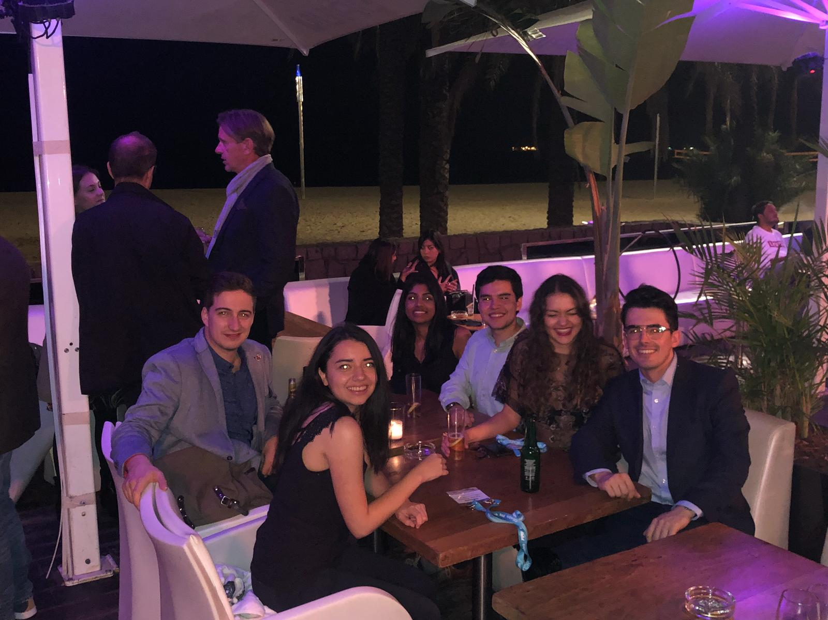
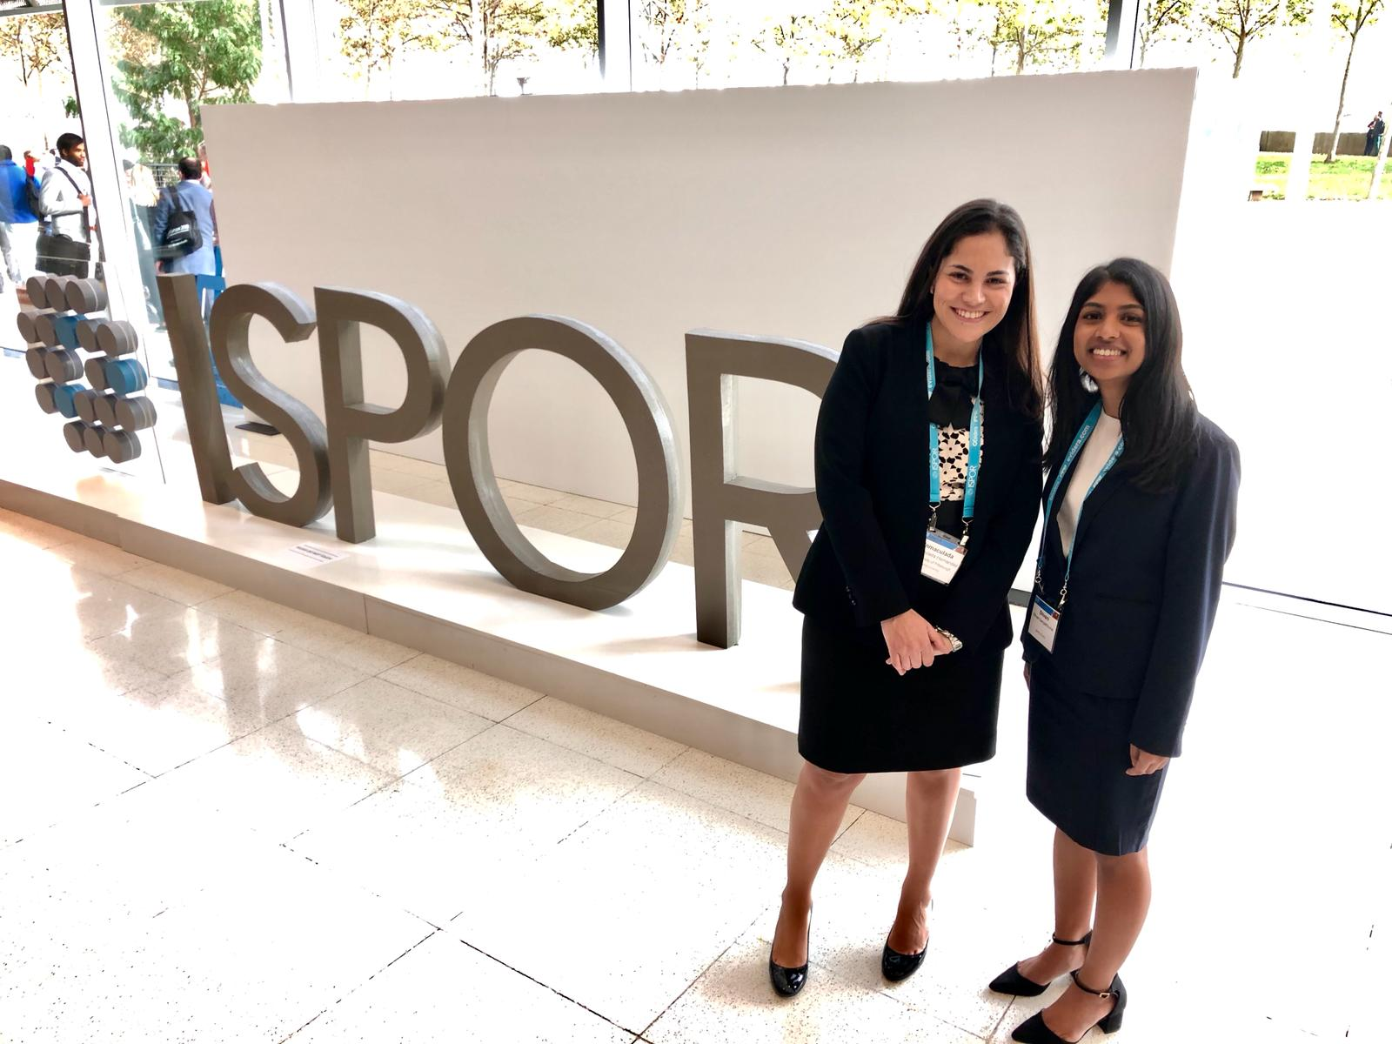
ISPOR Europe 2018 ▪ Barcelona, Spain
Shivani Sampathkumar (P4)

Slide 8
ISPOR at Pitt: Executive Board
President | Britney Stottlemyer
Vice President | Taylor Laffey
Business Manager | Colin Pfeiffer
PhD student Liaisons | Matt Gray & Alvaro San-Juan-Rodriguez
Chapter Advisor | Dr. Inma Hernandez
Current E-board members serving on a Student Network Committee for ISPOR:
Alvaro San-Juan-Rodriguez, Meeting Planning Committee

Slide 9
Why become a member of ISPOR?
Networking and Volunteer Opportunities
Leadership Positions
  P1 Student Representative
  Student Network Committees
Career Development and Exposure
  Guest and Faculty Lectures
  Career Round tables

Slide 10
Become our P1 Rep!
Responsibilities:
  Attend Eboard meetings and GBMs
  Point of contact for P1 class
  Promote ISPOR events
  Help Eboard in planning various events
  throughout
  Deadline: Wednesday, Sept. 25th by 3:00 pm
How to apply:
  Complete a short paragraph explaining previous leadership experience and interest in ISPOR
  Send applications to Taylor Laffey, P2 (tnl9@pitt.edu)
  Brief interviews will conducted in the upcoming weeks

Slide 11
ISPOR Membership Information
When can you join ISPOR?
  P1 year!
How much are membership fees?
  Pitt ISPOR Student Membership: $10
  ISPOR International Membership: $45 → enter the code StudentRecruit19
Deadline for membership form and dues: Wednesday, October 2nd
  Turn membership forms into: Britney Stottlemyer or any ISPOR officer in your respective class!

Slide 12
Upcoming Events
Career Round Tables: October 16th (tentatively)
Trivia Happy Hour with Duquesne ISPOR Chapter: November 8th
Webinar Series: November 20th (tentatively)
  Future dates to come from Duquesne ISPOR Chapter
We want to hear from you!
  A brief survey will be sent out later this week to gauge what areas people are most interested in and hope to get of being a member of our organization

Slide 13


Follow us on social media for more updates!
Pitt ISPOR Member Page
ispor.pitt

