Slide 1
SSHP Professional Projects
Join our Facebook group:
SSHP Professional Projects 2018-2019

Slide 2
Poison Prevention
Mr. Yuk
Educates kids in pre-school-1st grade about poisons and what to do if someone ingests something toxic
Monday’s around 4 pm, variable
Alcohol Education
Educates freshman about what to do if someone drinks too much & busts myths about alcohol consumption
Sunday afternoons/evenings
Opioid
Sci-Tech week at Carnegie Science Center
First week of November
Teaches high school students about overdose and narcan
Contacts: Kelly Jenniches (kaj60@pitt.edu), Megha Patel (map273@pitt.edu), Alissa Pastino (arp108@pitt.edu)

Slide 3
Antibiotic Stewardship: pittantibioticstewardship@gmail.com
Problem - bad bugs, no new drugs
2050: ABX-R mortality to surpass cancer
19yo F successful remission after AML. ~1 year later, resistant Pseudomonas infection. Colistin (nephrotoxic) failed, fell into septic shock, and succumbed within 48 hours.
Daptomycin (+) 15 years ago, fluoroquinolones (-) over 40 years ago
Stewardship - prudent use of antibiotics in clinical settings
Now required by Joint Commission in federally funded hospitals
Often led or co-led by pharmacists → opportunity!
Project Opportunities:
Antibiotics Awareness Week: November 12 - 18th
Be Antibiotics Aware
IDstewardship.com - publication opportunity!
Interprofessional Case Conference
Guest speakers - great team at UPMC (Potoski, Falcione, McCreary, Marini)

Slide 4
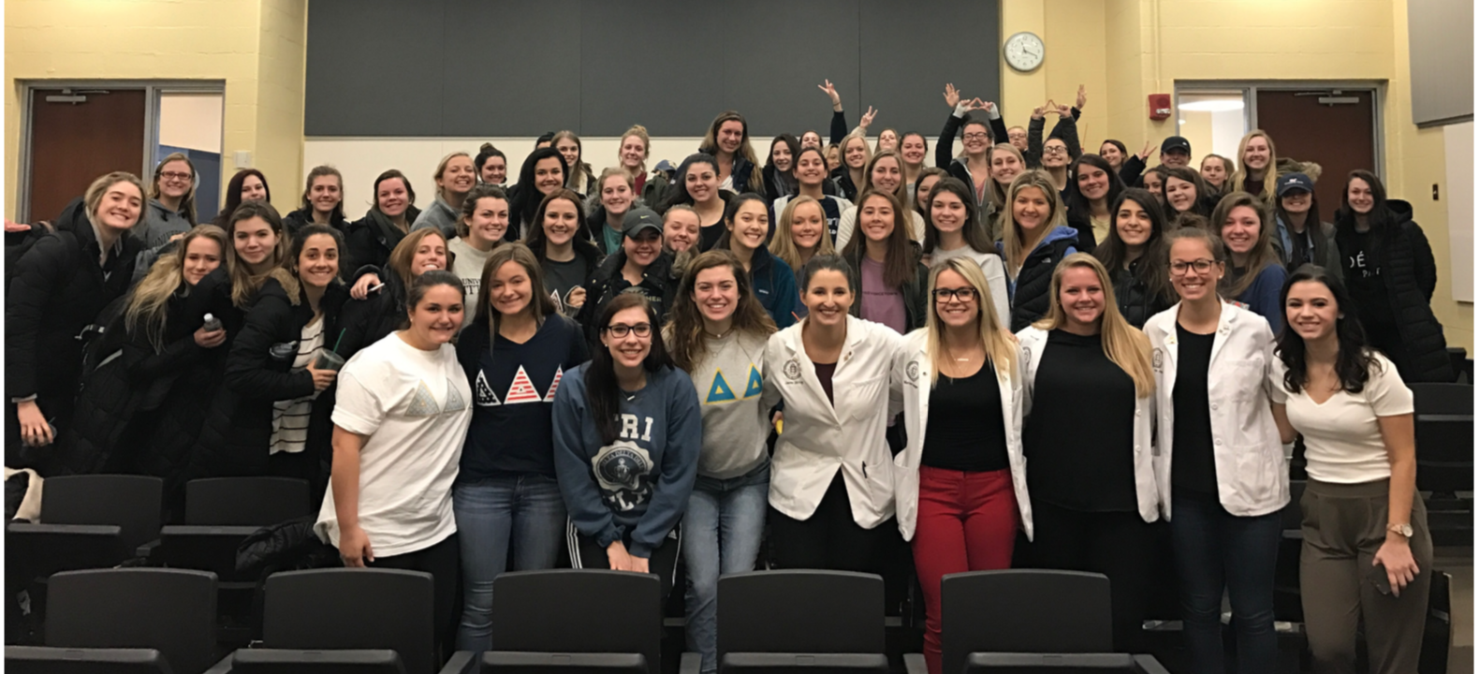
Contraception
Students host workshops with different groups of women on campus
Sororities
Residence Halls
Q & A style workshop
Expanded this year beyond contraception to include additional women’s health topics
STIs
UTIs
Contacts:
Marissa Campagna
(mlc113@pitt.edu)
Madison McConnell
(mgm62@pitt.edu)

Slide 5
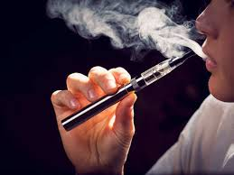
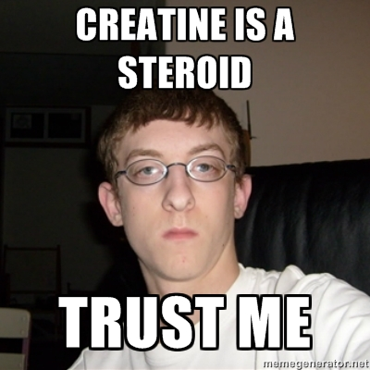
Men’s Health
Deliver a pre-made presentation/tabling about a selected topic by group
Exercise/form and injury self-care
Dietary/lifting supplements
Substance use/abuse, Smoking/Vaping
Common disease states affecting young and elderly men
Sexual health & STIs/HIV
Sites
ASCEND, The Climbing Wall, Rite Aid, Giant Eagle
Campus fraternities
Contact
Rish Arora (raa139@pitt.edu)
Mitchell Mirabile (mem259@pitt.edu)

Slide 6
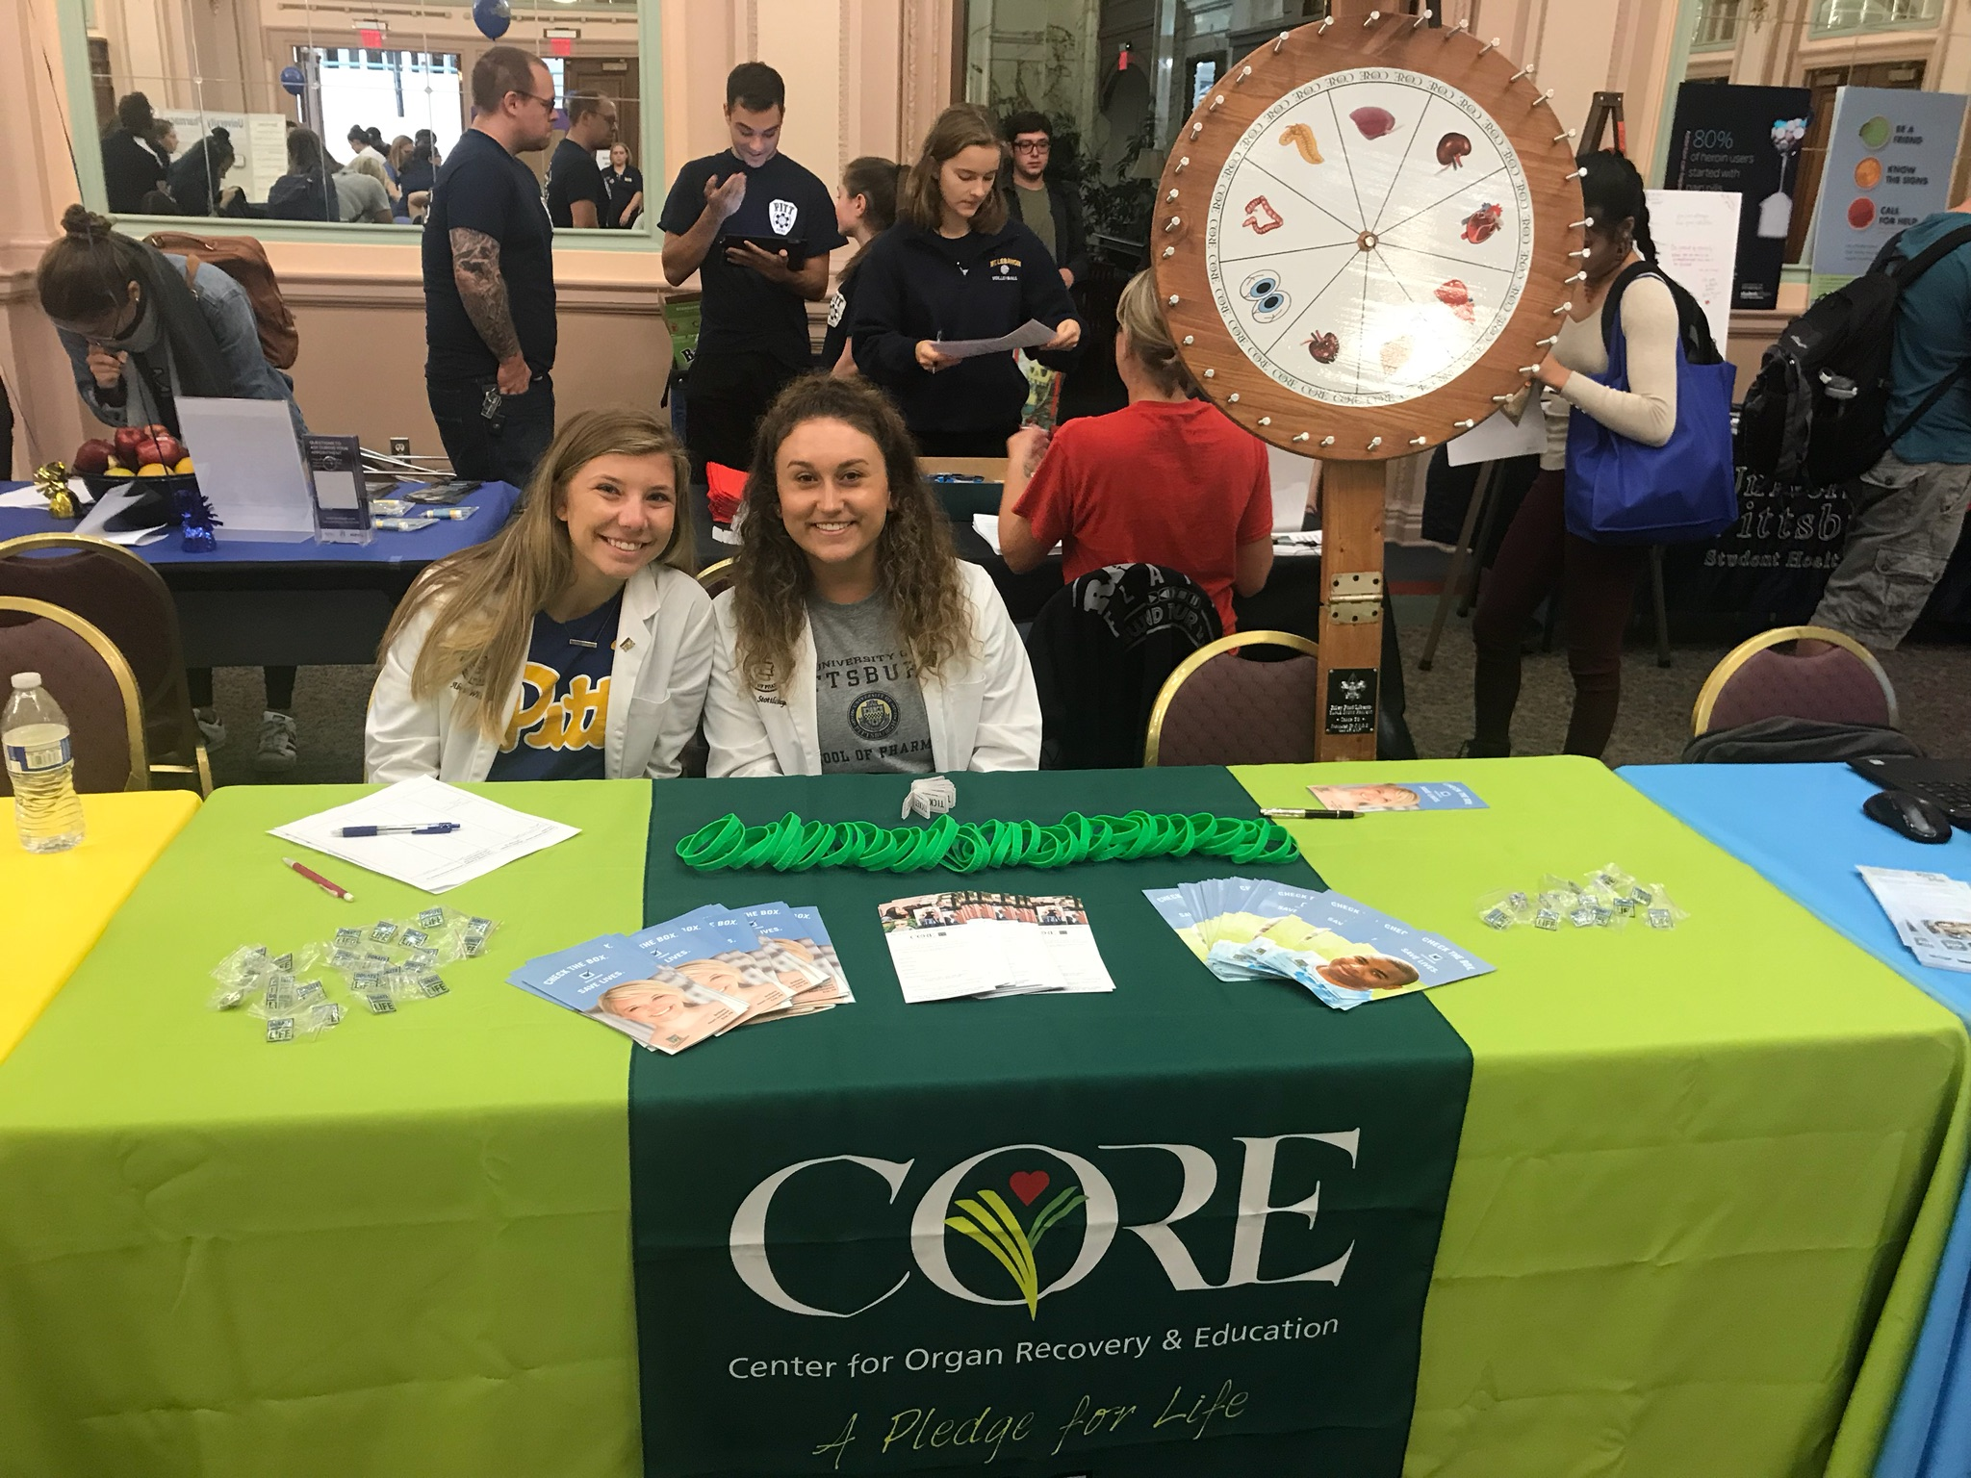
Organ Donation Awareness
Partner with the Center for Organ Recovery and Education
not-for-profit organ procurement organizations
Healthy U Fair
Transplant pharmacy lectures with Dr. Schonder
Learn about what it means to be part of the team in the transplant unit
High School Presentations
Organ Donation Awareness Day in April
Contact info
Jarad (jwi8@pitt.edu)
Abbey (amw224@pitt.edu)

Slide 7
Psychiatric Support
Students table at Forbes Pharmacy and Mercy Behavioral Health
Fall: 10/4 (1-3PM) ; 11/27 (12-2PM) ; TBD
Educate patients with mental illness about current immunizations
Flu shot, Hepatitis C vaccine, and HPV vaccine
Inform patients about the importance of medication adherence
Information sheets, tips and reminders to help them remember
Spring:
Educate patients on OTC medications
Different OTC medications that have no negative interactions with their Rx
Informative session on disease states
Serve a supportive resource for vulnerable population with Dx like diabetes
Contact info: Polina (pol12@pitt.edu) & Dana (daa68@pitt.edu)

Slide 8
Be sure to sign in and indicate which projects you are interested in
Contact us: pitt.sshp@gmail.com
Facebook: SSHP Professional Projects 2018-2019
Funto Babalola olb13@pitt.edu & Niti Patel nmp58@pitt.edu

