Slide 1
How to Zotero
PittPharmacy

Slide 2
Start by downloading and installing “Zotero 5.0” AND “Zotero Connector”
Download both at: https://www.zotero.org/download/
You may need to make a free account.
Zotero 5.0 is the main software
Zotero connector adds a button to your internet browser (Chrome, Safari, etc.) that allows you to automatically cite an article from the internet.
See next slide for screenshots of how to use Zotero Connector on Google Chrome

Slide 3
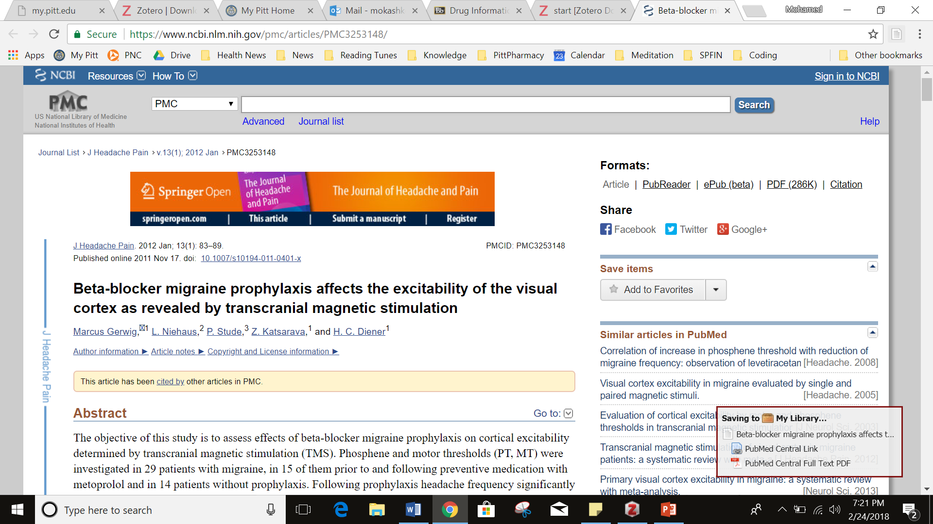
Click here to save article
This will show up when Zotero recognizes the article and saves it
Zotero shortcut

Slide 4
How to cite using Zotero (After saving the article via Zotero Connector)
Open Zotero
Find the article in your library
Right-click on the article
Click “Create Bibliography for Item…”
Make sure the same options are selected
Citation Style = American Journal of Health-System Pharmacy
Output Mode = Bibliography
Output Method = Copy to Clipboard
Click “OK”
Right-click and click “Paste” into your desired document for your citation!
Edit citation as necessary (see email for minor differences between Zotero citation and what PittPharmacy wants)
NOTE: SCREENSHOTS ON NEXT 3 SLIDES

Slide 5
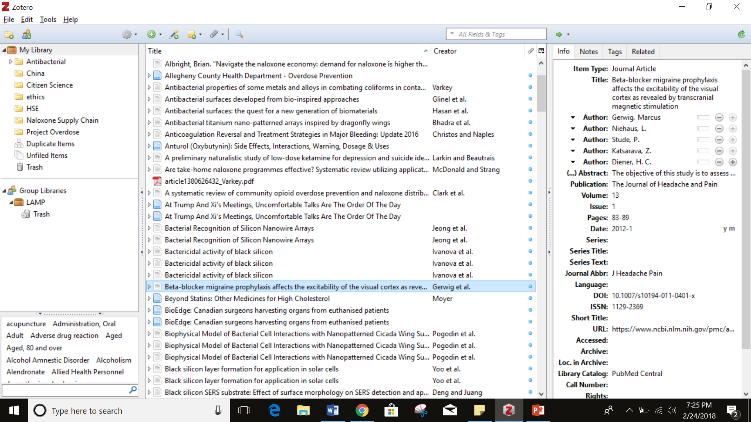

Slide 6
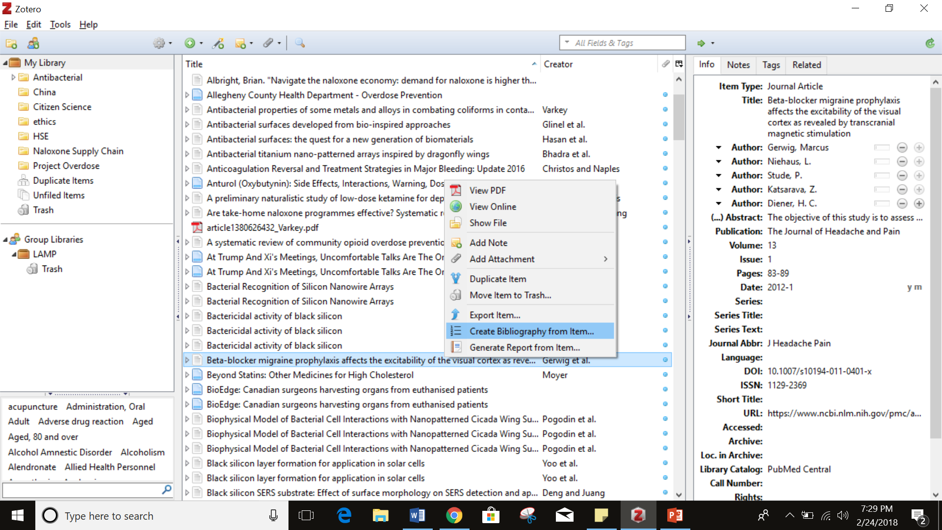

Slide 7
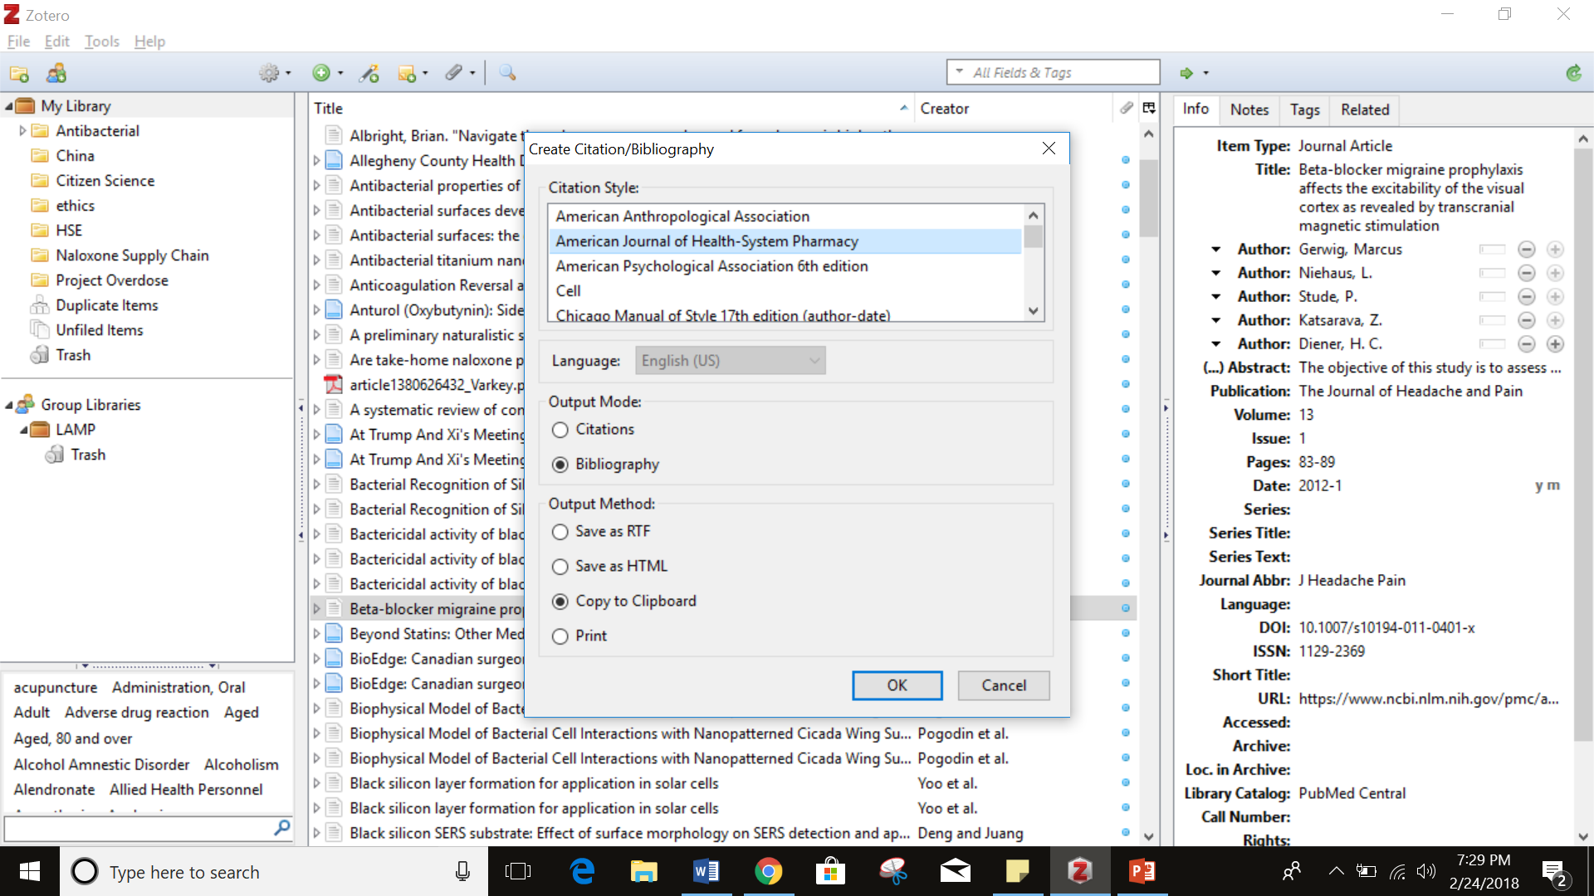

Slide 8
What it will look like when you’re done and things to edit:
Zotero ASHP Style:
Gerwig M, Niehaus L, Stude P, Katsarava Z, Diener HC. Beta-blocker migraine prophylaxis affects the excitability of the visual cortex as revealed by transcranial magnetic stimulation. J Headache Pain. 2012;13(1):83-89. doi:10.1007/s10194-011-0401-x
PittPharmacy Style:
Gerwig M, Niehaus L, Stude P, et al. Beta-blocker migraine prophylaxis affects the excitability of the visual cortex as revealed by transcranial magnetic stimulation. J Headache Pain. 2012;13(1):83-89.
"List all authors when four or fewer; when five or more, list only the first three and add et al.” – Pitt style sheet. Also delete the “doi”.

Slide 9
Basic Zotero does not come with the ASHP format. Here’s how to add it on easily.
Open Zotero
Go to the toolbar and click “Preferences”
Click “Cite”
Click “Styles”
Click “Get additional styles…” (will take you online)
Find “American Journal of Health-System Pharmacy” and click the link. It will begin downloading a “.csl” file. Open file when complete.
Go back to Zotero and click “install” (opening the .csl file should have automatically taken you back to Zotero)
You’re done!
NOTE: SCREENSHOTS ON NEXT 4 SLIDES

Slide 10
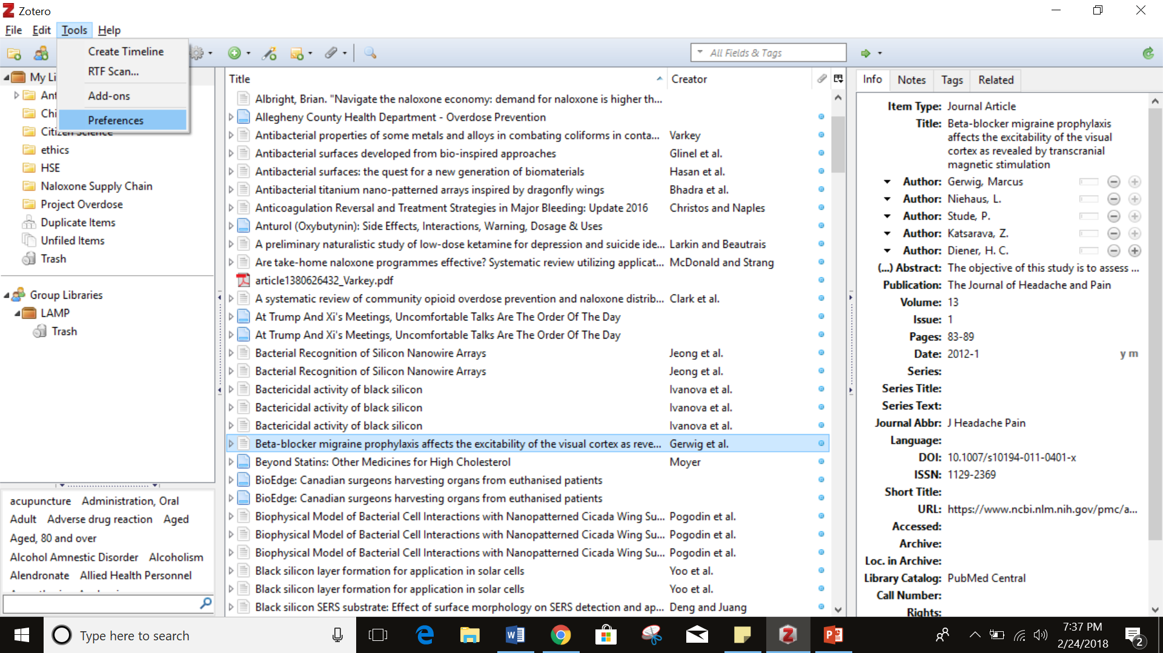

Slide 11
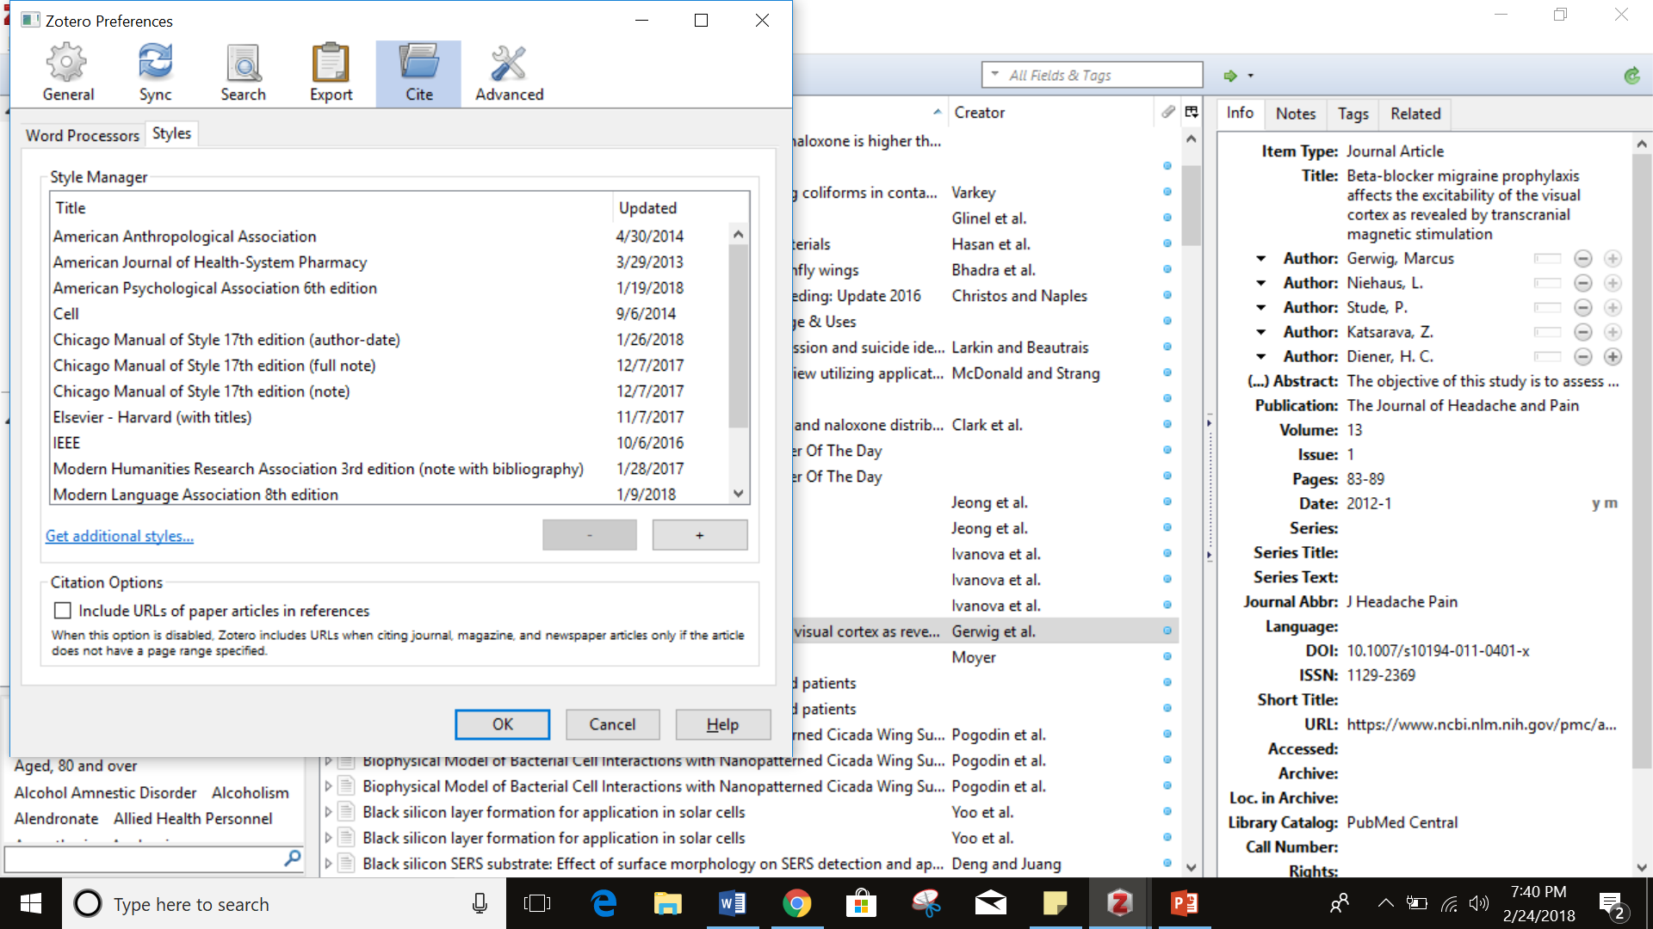

Slide 12
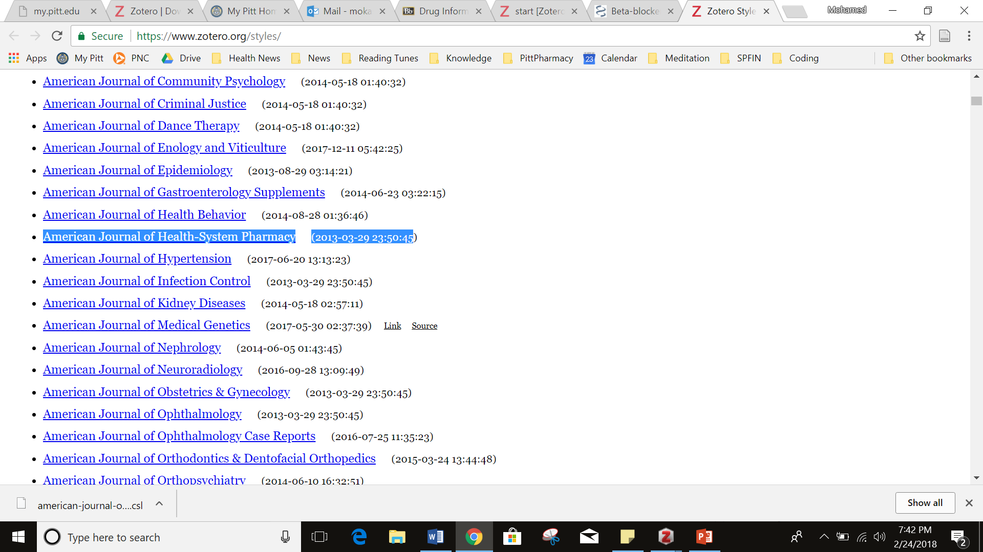
Click download link
Open download

Slide 13
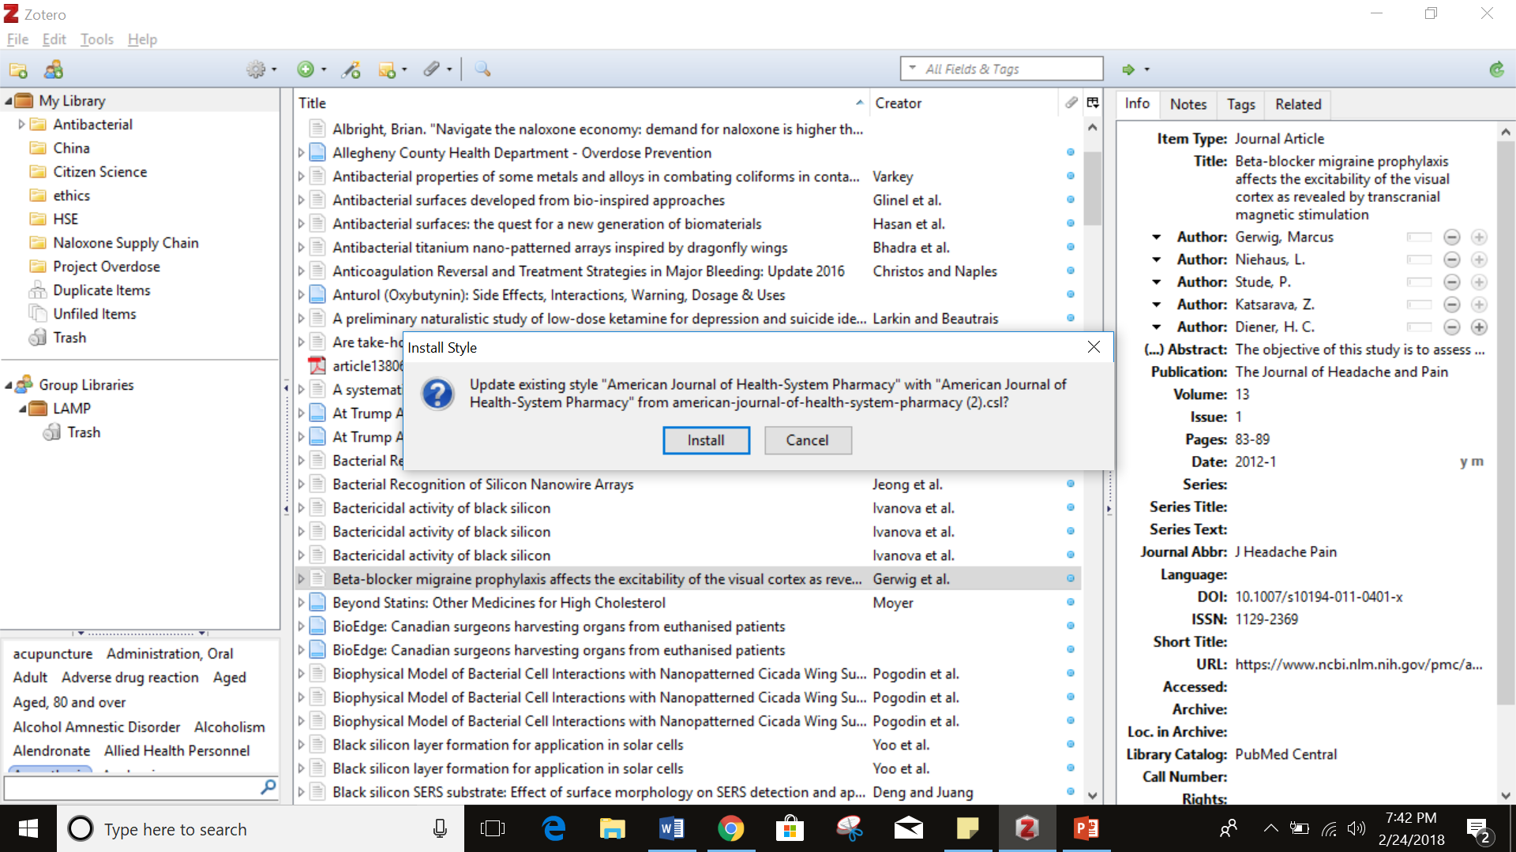

Slide 14
Enjoy!
Please let me know if you’re having any trouble

