Slide 1
TimeTree App FAQ/Concerns

Slide 2
1) Too many notifications! How do I turn them off?
Step 1 – click on “Menu” button (four horizontal lines) in top left corner
Step 2 – click on “App Settings” button (gearwheel icon)
Step 3 – click on “App notifications” slider (or any other notifications you want to turn off, such as “Allow Today’s Notifications”)
Color = notifications on
Gray/white is off = notifications off
When completed, no notifications will be received from the app.
Please see next slide for screenshots

Slide 3
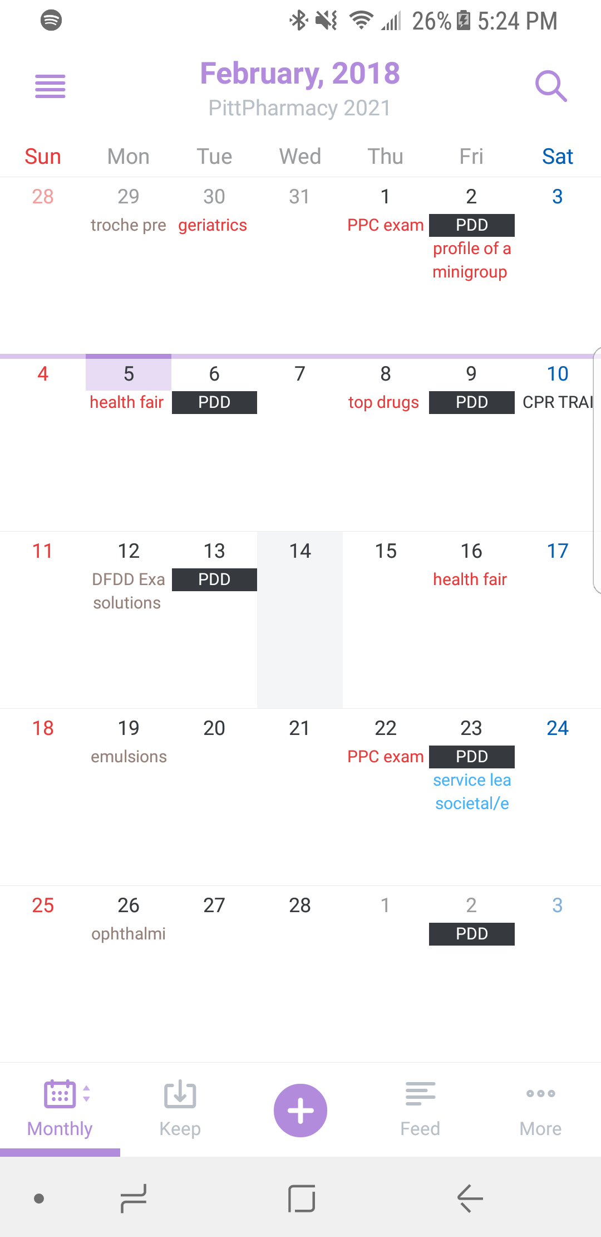
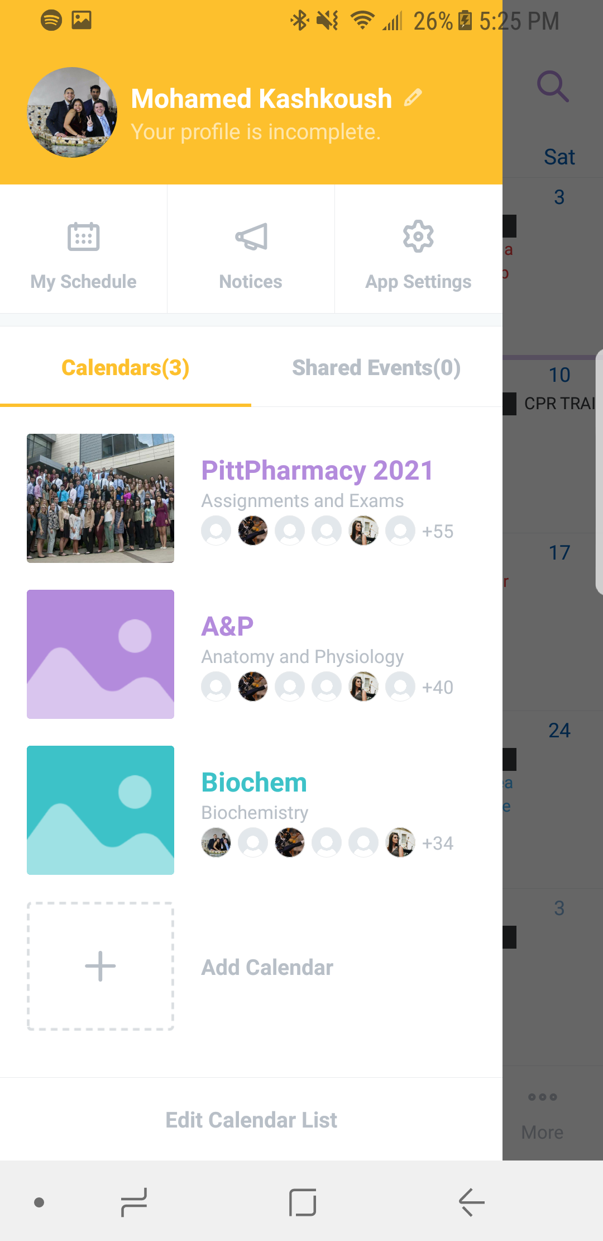
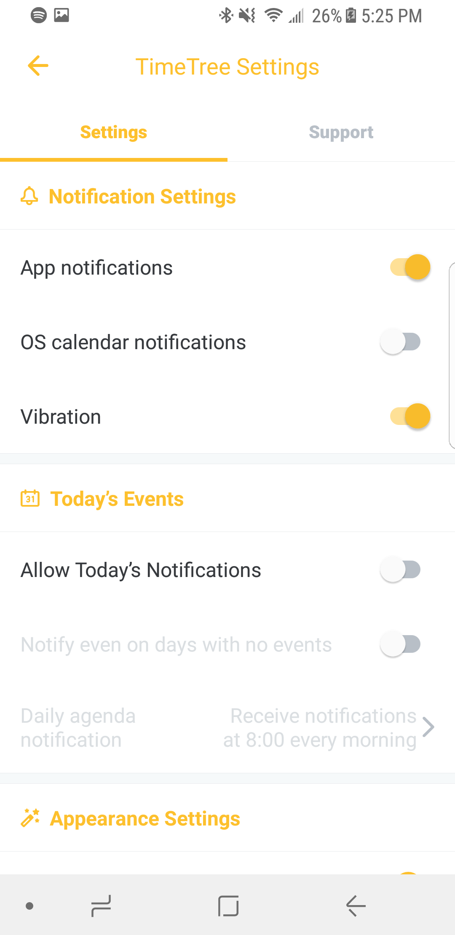
Click here
Click here
Click here

Slide 4
2) When will I receive a notification if I leave them on?
24-hours before every assignment/exam
Whenever someone joins the calendar
These will stop once everyone signs up. If you want notifications on, but not everytime someone joins, one solution is to temporarily turn them off.
Whenever an assignment is added, deleted, or edited

Slide 5
3) The 3 calendars (PittPharmacy 2021, Biochem, A&P) are all separate. How do I combine them into one calendar?
Step 1 – click on “Menu” button (three horizontal lines) in top left corner
Step 2 – click on “My Schedule” button (calendar icon)
Notice the changes
PittPharmacy 2021 (1 calendar) → your personalized schedule (combines all calendars you are enrolled in)
Notice absence of A&P Exam 2 → presence nce of A&P Exam 2
Please see next slide for screenshots

Slide 6
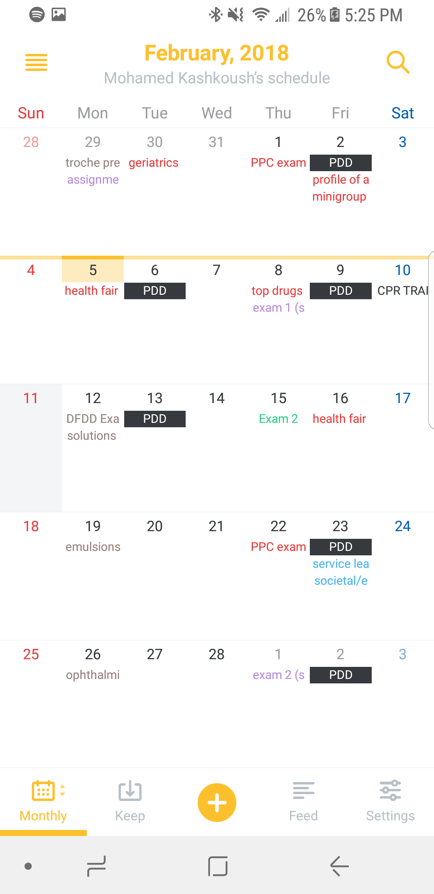
Click here
Click here

Slide 7
4) The monthly view has boxes that are too small, making text hard to read. How do I use a weekly view? Or a day-by-day summary view?
Step 1 – hold down the “Monthly” button in bottom left corner
Step 2 – click “Weekly” button for weekly view OR “Summary” button for day-by-day summary
Please see next 2 slides for screenshots
Weekly view pictured in next slide
Day-by-day summary view in 2 slides
Notice changes

Slide 8
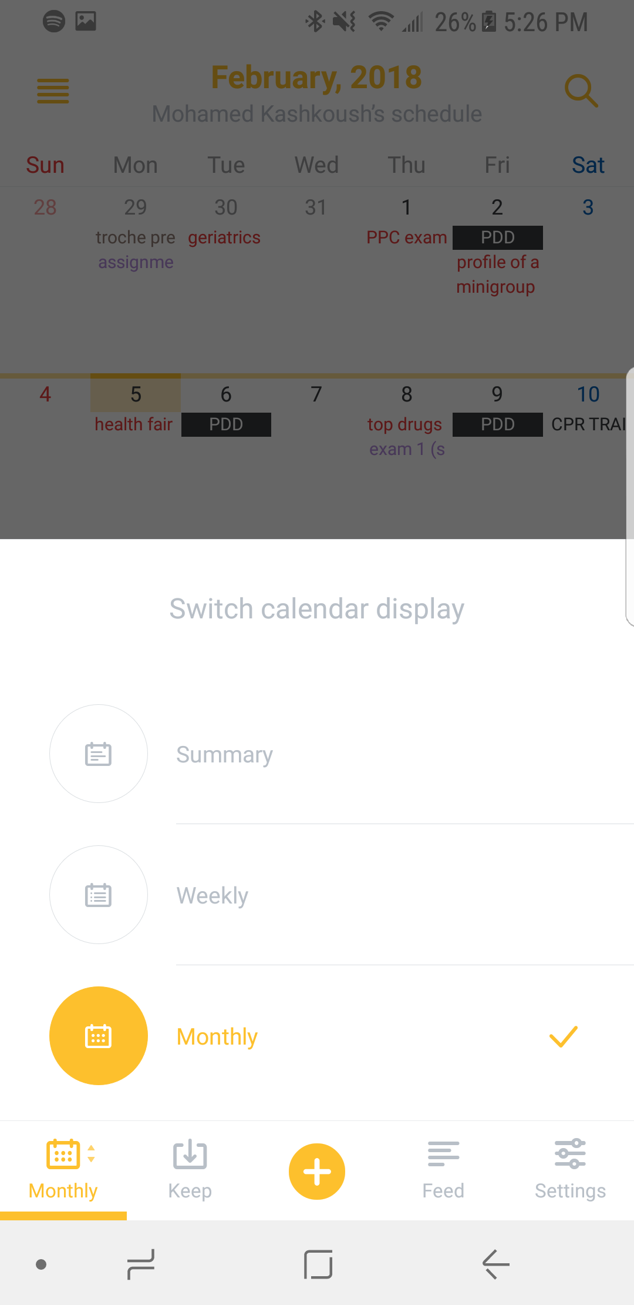
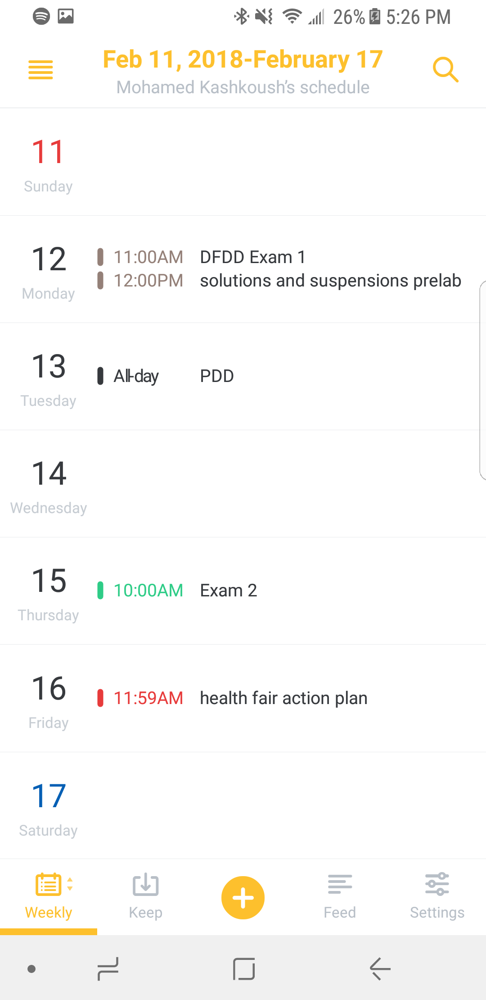
Click here
HOLD here

Slide 9
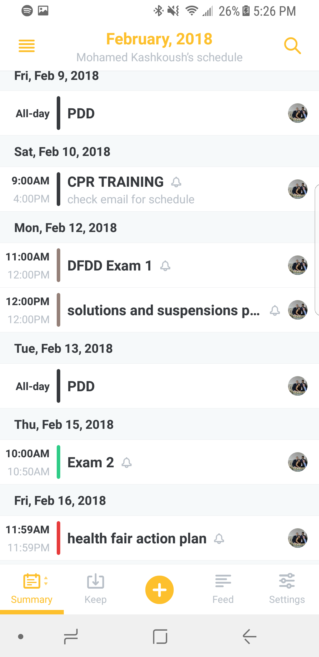
Click here
HOLD here

Slide 10
5) I like viewing my schedule on my computer. How can I open TimeTree on a desktop view?
Step 1 – go to https://timetreeapp.com/
Step 2 – log in if you have not already
Step 3 – select calendars you want to view
Click on “Menu” button (four horizontal lines) in top left corner
Click on “Select all” button (double check-mark icon) to choose all calendars you are enrolled in
Please see screenshots on next 3 slides

Slide 11
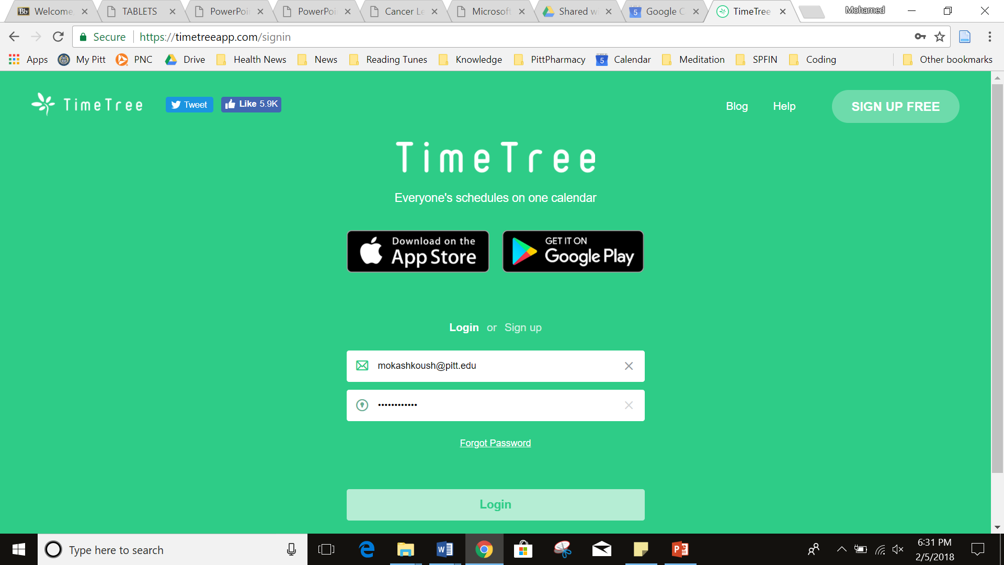

Slide 12
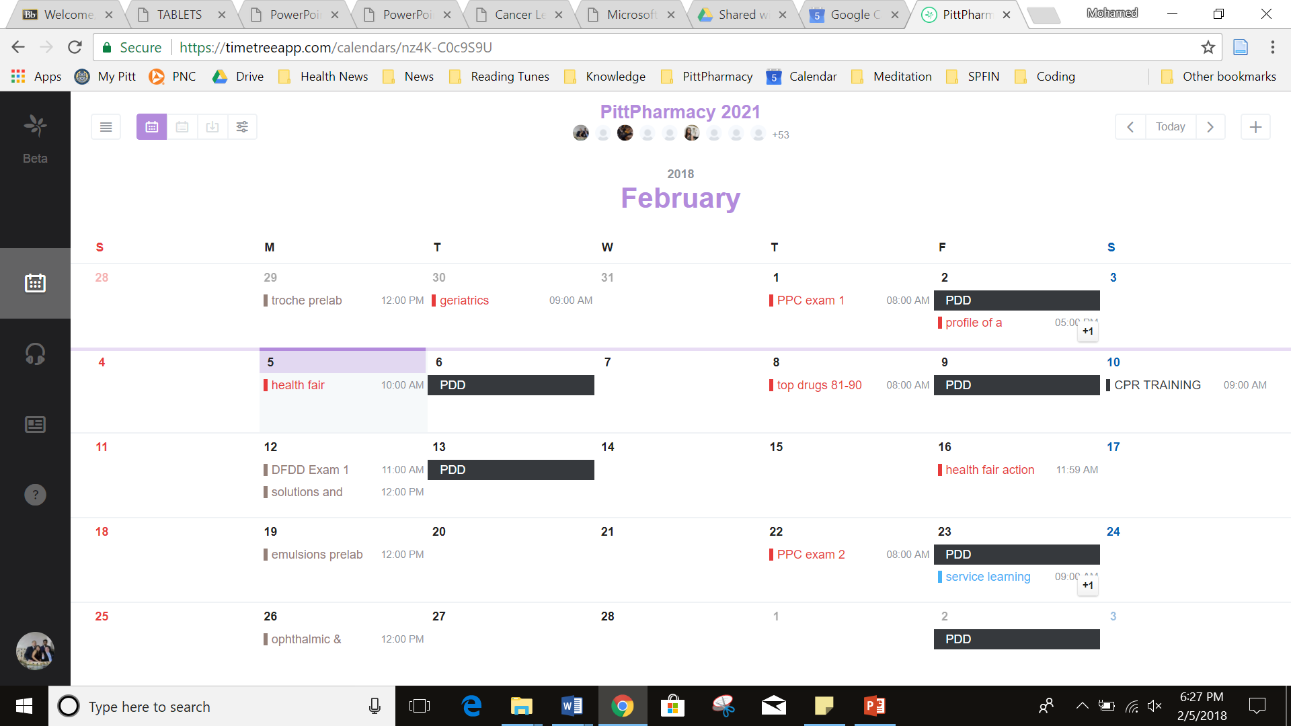

Slide 13
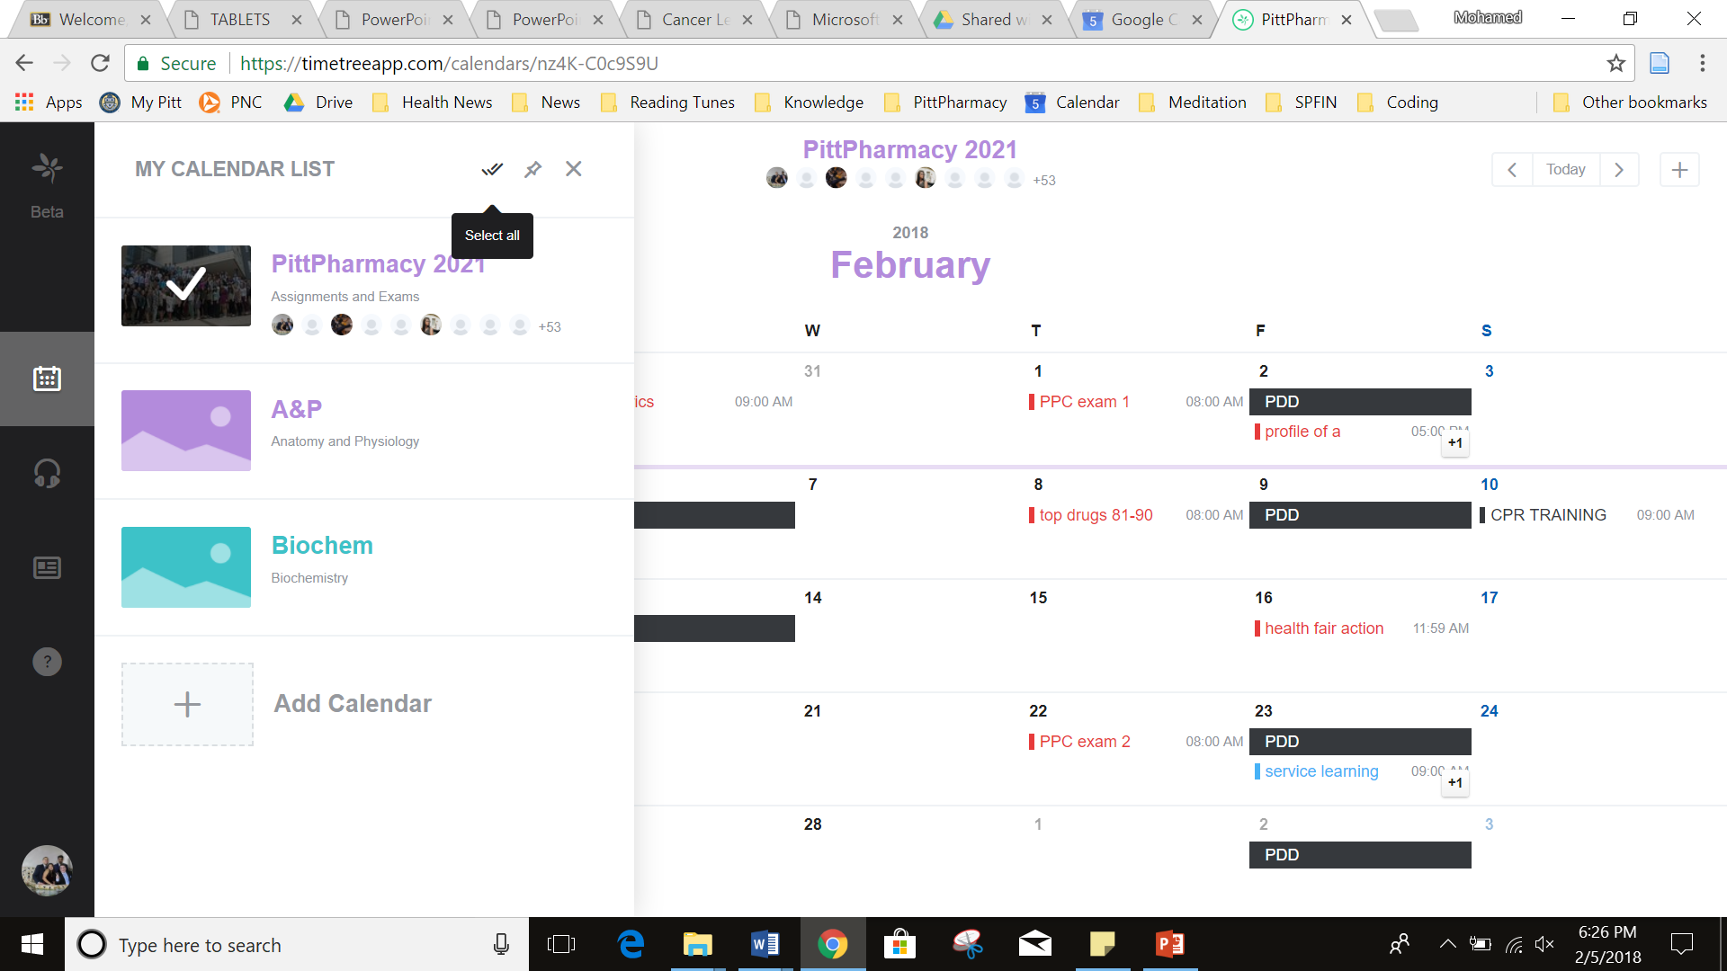

Slide 14
