Slide 1
SSHP
Student Society of Health-System Pharmacists

Slide 2
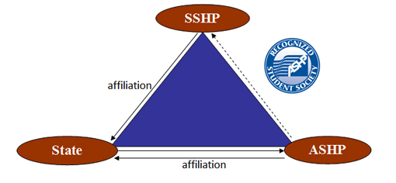
SSHP as a part of ASHP National

Slide 3
Who is ASHP?
American Society of Health-System Pharmacists
Celebrating 75 years of improving medication use and enhancing patient safety
Organization consisting of over 40,000 members which include pharmacists, pharmacy interns and pharmacy technicians

Slide 4
What is a Health-System Pharmacist?
MORE than just hospital pharmacy!
Ambulatory Care
Home Care
Long-term Care
Information Technology
Management and much more!

Slide 5
What does ASHP do?
Accreditation Council
Pharmacy Residency Programs, Technician Training Programs
Education and Advocacy
Drug Information Services
Meetings and Conferences
Mid-Year Clinical Meetings (December; Orlando, Florida!)
Residency Showcases
Professional Policy and Practice Standards
Career Development
Publishing

Slide 6
ASHP Accredited Residency Programs
PGY-1 and PGY-2 Training Programs Available
PGY-1→Generalist Training
3,480 Positions Available for 2017 Phase 1 Match
PGY-2→Advanced Specialty Training
1,112 Positions Available for 2017 Phase 1 Match
Areas of Residency Training
Critical Care, Ambulatory Care, Solid Organ Transplant, Pediatrics, Oncology, etc.
2017 Match Process Results
PGY-1→ 93% Fill Rate in Phase 1 Match
Overall Position Fill Rate for PGY-1 and PGY-2 for 2017 = 98.1%

Slide 7
Who belongs to ASHP?
Pharmacists
Student Pharmacists
Pharmacy Technicians
Over 44,000 members!

Slide 8
Benefits of ASHP Membership
Free CV review program
Deadline for this fall: August 18-September 8th
Feedback from ASHP
***Discount of $100 off mid-year registration fee***
Apply for Awards
Student Leadership Award of $2000
Deadline: January 30, 2018
Student Research Award of $1500
Deadline: June 2018
Additional $1000 towards Mid-Year Conference

Slide 9
Benefits of ASHP Membership cont.
Apply for a P4 APPE Rotation
Opportunities at ASHP Headquarters (Bethesda, MD)
Apply for Summer Internship Program
10 week internship
P1-P3 student opportunity
Deadline for Application due December 31, 2017***
Executive Committee
Serve as a liaison for ASHP and colleges of pharmacy across the country
Councils, Committees, and Advisory Bodies
Discuss issues and recommend policy at 5 different committee hearings

Slide 10
ASHP Mid-Year Conference 2017
December 3-7
Orlando, Florida
What is Mid-Year?
“The ASHP Midyear Clinical Meeting is the largest gathering of pharmacists in the world. With its focus on improving patient care, the meeting is attended by more than 20,000 pharmacy professionals from 86 countries.” –ASHP.org
Additional Activities include: Poster Presentations + Case Studies
Guest Speaker for 2017…
MICHELLE OBAMA!

Slide 11
PSHP: Getting Involved on a State Level
Pennsylvania Society of Health-System Pharmacists
State Affiliate to Pitt!
Membership Fees: $28
PSHP Residency Showcase
What? Residency Showcase, Poster Presentation, Clinical Jeopardy Tournament, etc
When? October 11-13
Students do not have to attend all 3 days! Only Thursday the 11th is necessary
Where? Seven Springs Mountain Resort (about an hour from Pitt)
Who? Pharmacy student from all classes, highly recommended for P3s
How much? $39 for non-member, $19 with PSHP membership
Sign up today: http://www.pshp.org/?page=2017AAAgenda

Slide 12
SSHP at Pitt: Executive Board
President | Rachel Cartus
President-Elect | Caylee Sams
Vice-President | Jessica Chmielinski
Business Manager | Kiana Green
Professional Project Chair | Shrey Parekh
Professional Project Chair-Elect | Funto Babalola
Career Development Co-Chairs | Hannah Akerberg and Domenica Ricciuti
Fundraising Chair | Cameron Karnick

Slide 13
The Perks of Becoming a Member of SSHP
Networking and Volunteering Opportunities
Leadership Positions
P1 Student Representative
Professional Project Committees
Career Development and Exposure
Clinical Skills Competition (more information to come)
Guest and Faculty Lectures
Residency Preparation

Slide 14
SSHP Membership Information
When can you join SSHP?
P1 year!
What is the cost of membership?
$10 for SSHP membership
$28 for PSHP memberhsip
$50 for ASHP National membership
Deadline for membership form/dues: Tuesday, September 19th
Turn membership forms into: Caylee Sams or any SSHP officer in your respective classes!

Slide 15
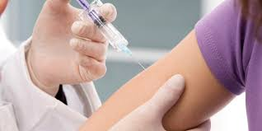
Professional Projects
Professional Project Chair
Shrey Parekh (smp116)
Professional Project Chair-Elect
Funto Babalola (olb13)

Slide 16
Poison Prevention Project
Project Leaders
Jordan Serio (jms456)
Kara Ioannou (kai25)
Kelly Jenniches (kaj60)
Project Summary
Alcohol Poisoning to undergraduate students
Naloxone presentation with SimMan at SciTech Days at Carnegie science center
Mr. Yuk presentation to younger children
Dr. Korenoski lecture on opioid presentation

Slide 17
Contraception Project
Project Leaders
Olivia Berger (olivia.berger)
Marissa Campagna (mlc113)
Project Summary
HPV vaccination, STD testing and contraception education to sororities and different women’s organization on campus
Answer one-on-one Q&A after presentation

Slide 18
Men’s Health Project
Project Leaders
Mitchell Mirabile (Mitchell.miraile)
Rish Arora (raa139)
Project Summary
Weight lifting supplements, Alcohol abuse, HPV vaccination, vaping
Present at clubs, fraternities, high schools
How to Get Involvedd
Research topics related to Men’s Health
Help create/give presentation

Slide 19
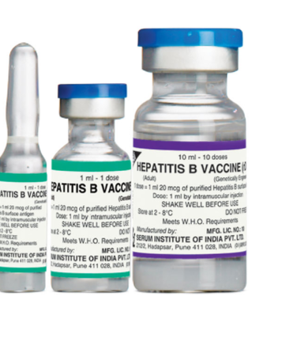
Mercy Behavioral Health/ Psychiatric Support Project
Project Leaders
Carly Gabriel (ctg12)
Miranda Steinkopf (mps67)
Project Summary
The project educates psychiatric patients at mercy behavioral health and veterans with mental illness on vaccines such as Flu and Hepatitis B. Regular patients that come to Forbes pharmacy and veterans at Harbor Light were also educated on diabetes/diet and exercise.

Slide 20
Travel Vaccination Project
Project Leaders
Luke Jennings (ltj5)
Michelle Miller (msm88)
Project Summary
Helps to guide students and Pitt community on vaccinations they may need when studying abroad
Pitt study abroad fair - 2nd week of September
Looking to expand to reach CMU, Habitat for Humanity, groups doing medical mission trips, etc.
How to get involved
Research vaccines needed for certain areas
Expanding to talk about new topics (Zika, other general health info. when going abroad)
Presentations

Slide 21
Upcoming Events
Back to School Picnic: TONIGHT!!
Next General Body Meeting: TBD
Clinical Skills Competition: October 2
Fleece SALE!! October TBD
Residency 101: Early October
PSHP Residency Showcase: October 11-13
SSHP Policy Week: September 25-28
ASHP Mid-Year Clinical Conference: December 3-7; Orlando, Florida

Slide 22
Follow us on Social Media for more info and updates!!
Facebook: University of Pittsburgh Student Society of Health-System Pharmacists @pittsshp
Twitter: @pittsshp
Instagram: @pittsshp
Any Questions?? pitt.sshp@gmail.com

